Slide 1
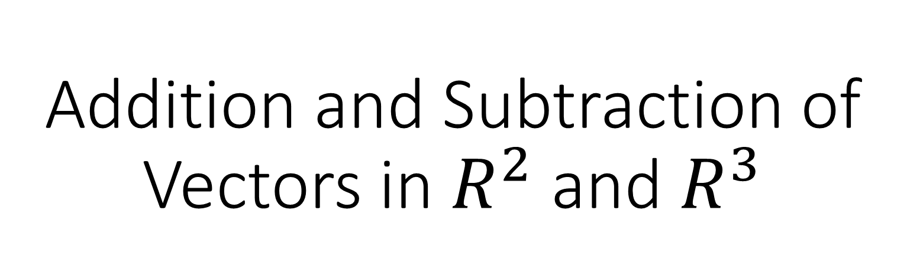
Addition and Subtraction of Vectors in $R^{2}$ and $R^{3}$

Slide 2

Any vector in the two-dimensional plane can be expressed in terms of the unit vectors $\vec{i}$ and $\vec{j}$ where $\vec{i}=\vec{(1,0)}$ and $\vec{j}=\vec{(0,1)}$
For example, $\vec{(−3,4)}=−3\vec{\left(1,0\right)}+4\vec{\left(0,1\right)}=−3\vec{i}+4\vec{j}$

Slide 3
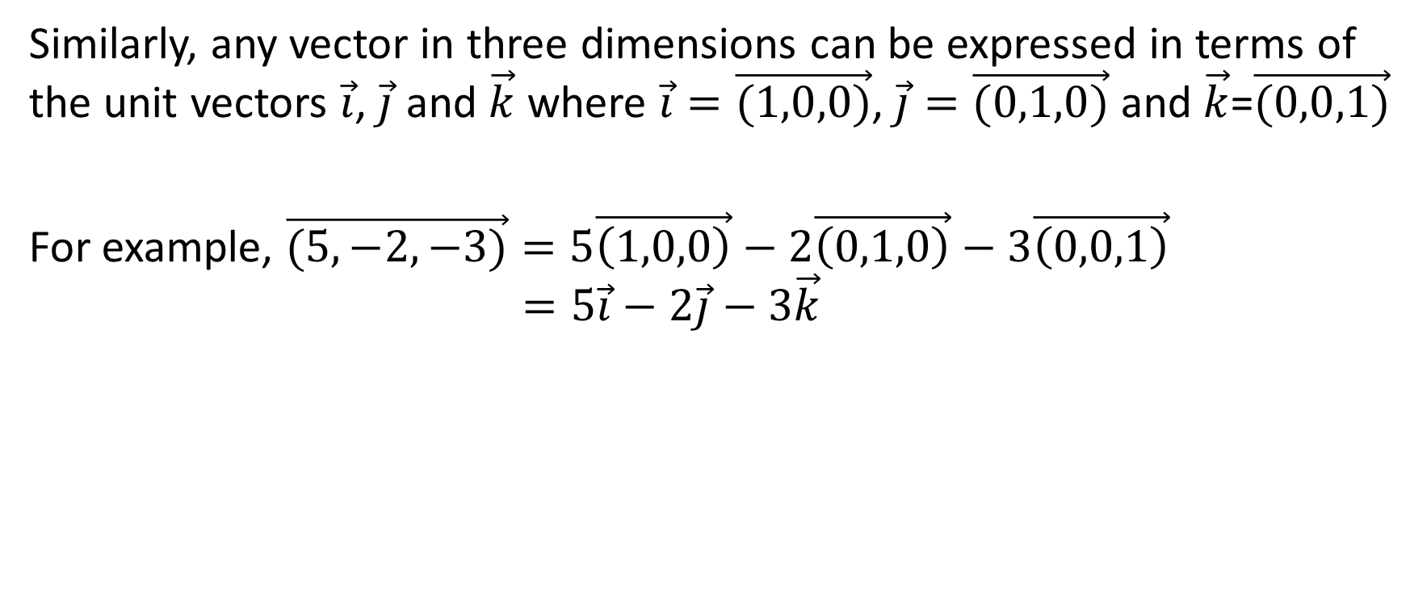
Similarly, any vector in three dimensions can be expressed in terms of the unit vectors $\vec{i}$, $\vec{j}$ and $\vec{k}$ where $\vec{i}=\vec{(1,0,0)}$, $\vec{j}=\vec{(0,1,0)}$ and $\vec{k}$=$\vec{(0,0,1)}$
For example, $\vec{(5,−2,−3)}=5\vec{\left(1,0,0\right)}−2\vec{\left(0,1,0\right)}−3\vec{\left(0,0,1\right)}$
$$=5\vec{i}−2\vec{j}−3\vec{k}$$

Slide 4

As a general rule, if $\vec{v}=\vec{(a,b)}$, then $k\vec{v}=k\vec{(a,b)}=\vec{(ka,kb)}$
For example, $5\vec{(2,−3)}=\vec{(10,−15)}$

Slide 5
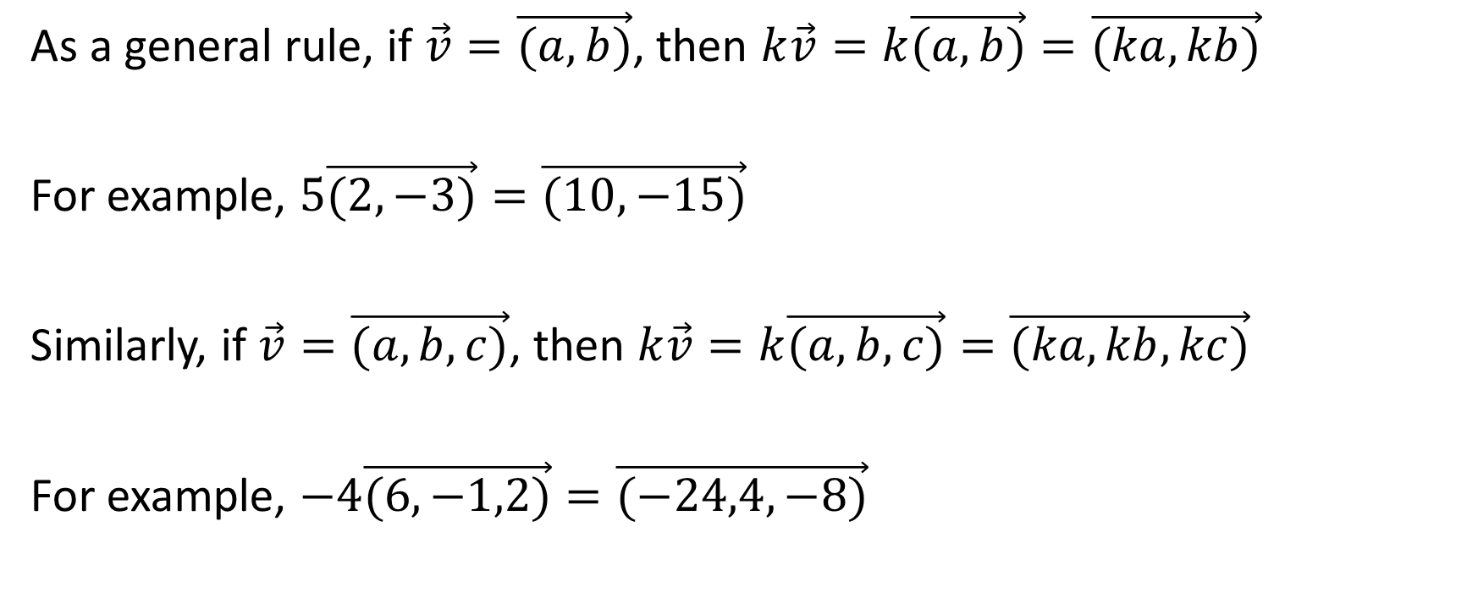
As a general rule, if $\vec{v}=\vec{(a,b)}$, then $k\vec{v}=k\vec{(a,b)}=\vec{(ka,kb)}$
For example, $5\vec{(2,−3)}=\vec{(10,−15)}$
Similarly, if $\vec{v}=\vec{(a,b,c)}$, then $k\vec{v}=k\vec{(a,b,c)}=\vec{(ka,kb,kc)}$
For example, $−4\vec{(6,−1,2)}=\vec{(−24,4,−8)}$

Slide 6
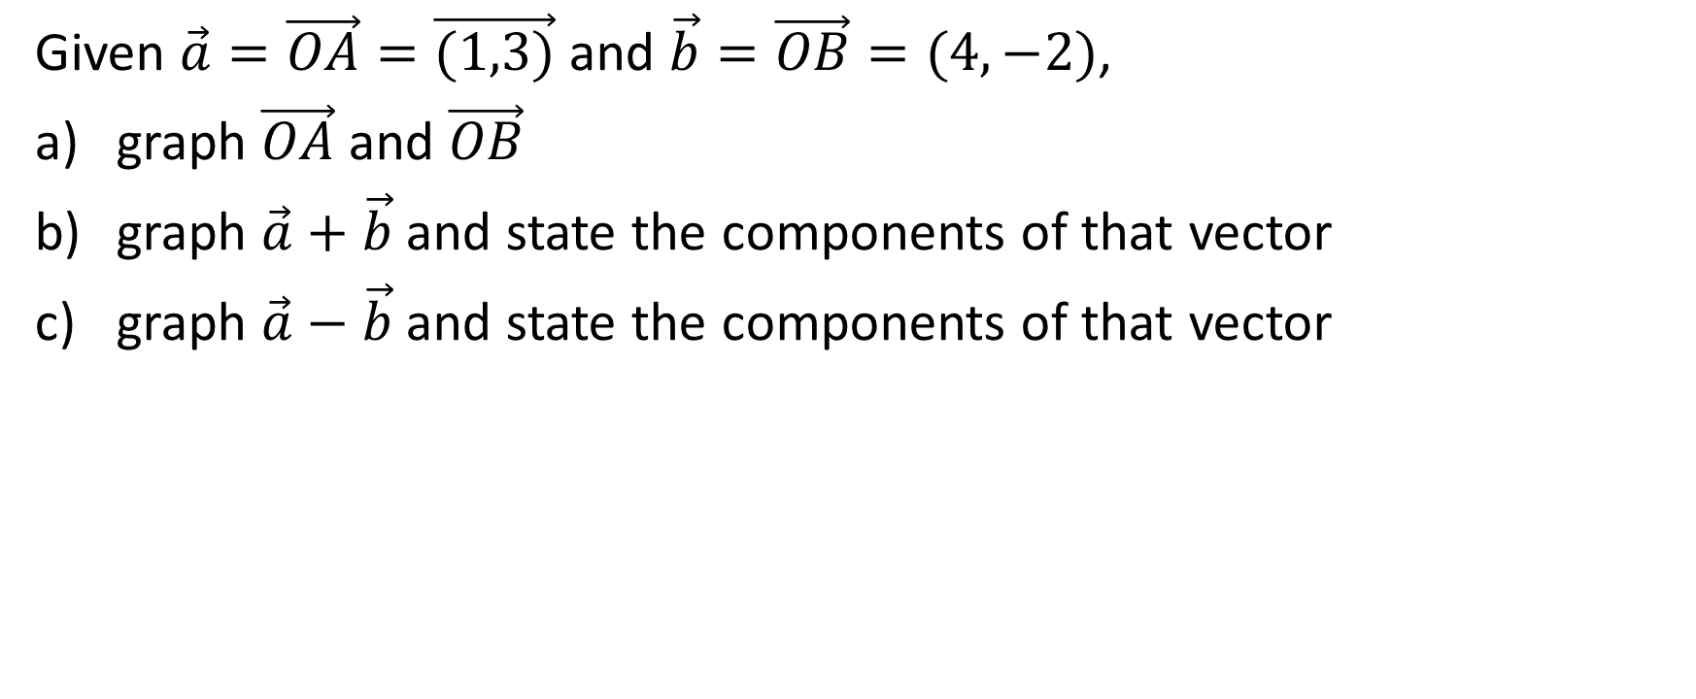
Adding and Subtracting Vectors
Given $\vec{a}=\vec{OA}=\vec{(1,3)}$ and $\vec{b}=\vec{OB}=(4,−2)$,
graph $\vec{OA}$ and $\vec{OB}$
graph $\vec{a}+\vec{b}$ and state the components of that vector
graph $\vec{a}−\vec{b}$ and state the components of that vector

Slide 7
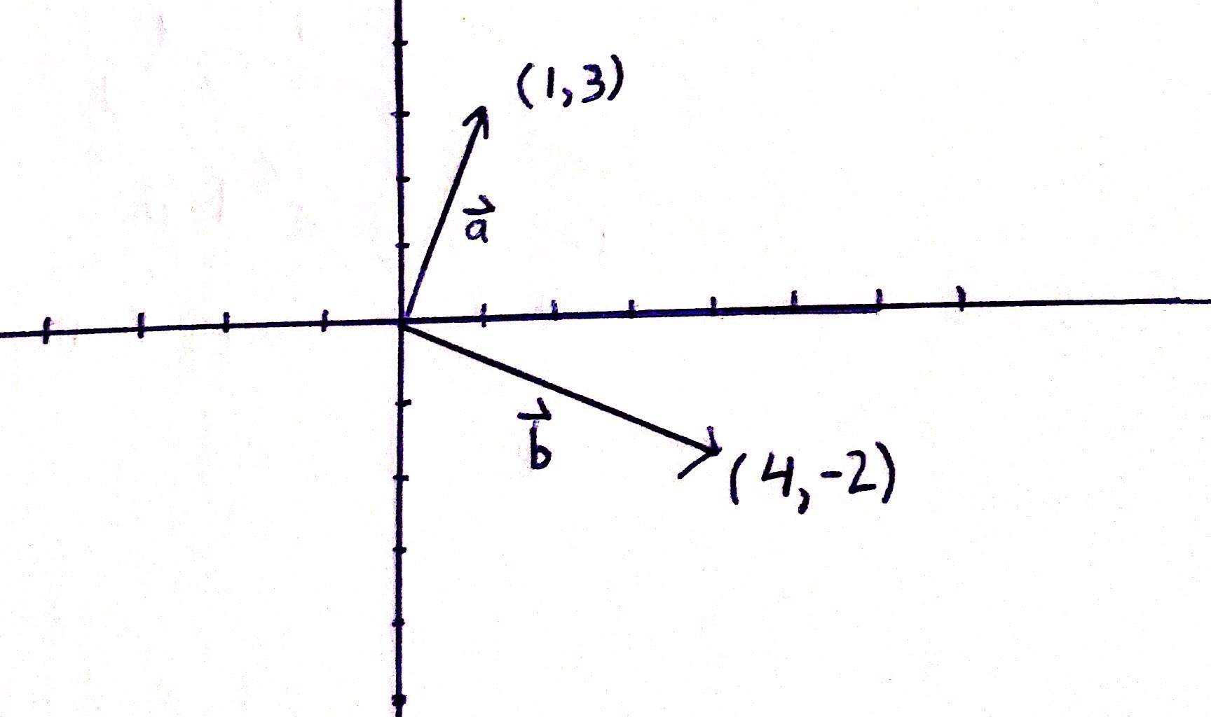
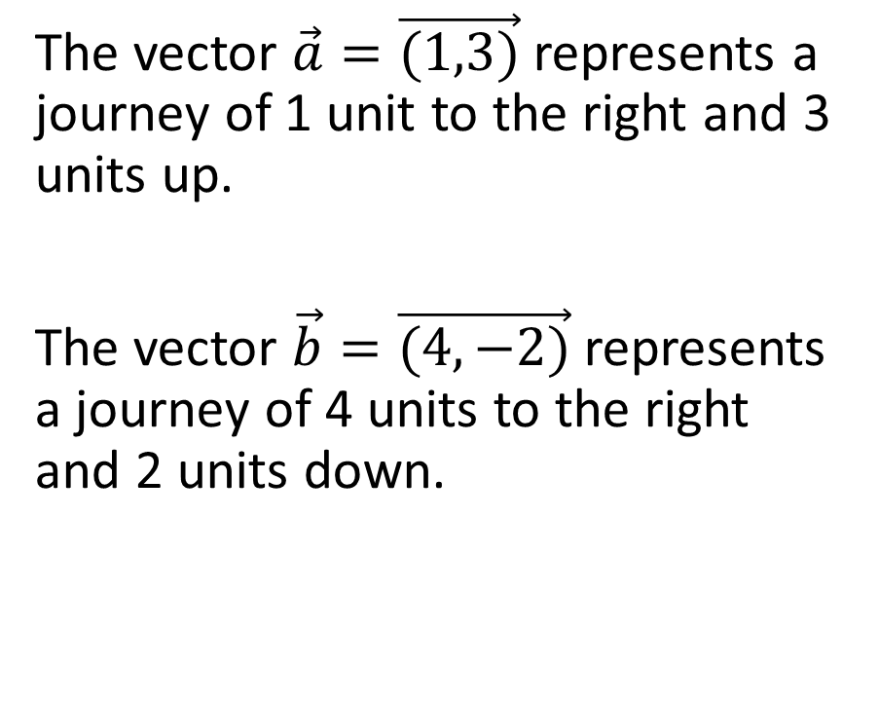
a)
The vector $\vec{a}=\vec{(1,3)}$ represents a journey of 1 unit to the right and 3 units up.
The vector $\vec{b}=\vec{(4,−2)}$ represents a journey of 4 units to the right and 2 units down.

Slide 8
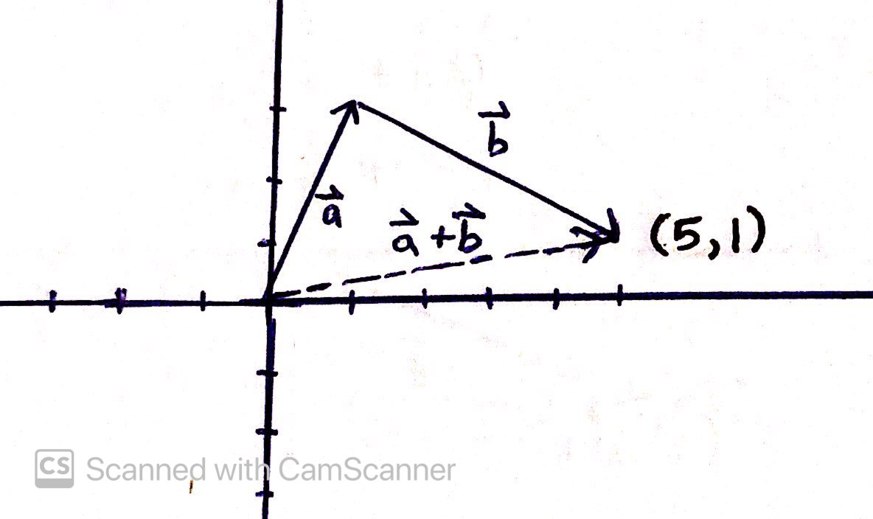

b)
If we are to add vector $\vec{a}$ and vector $\vec{b}$, we can do so by the tip-to-tail method.

Slide 9
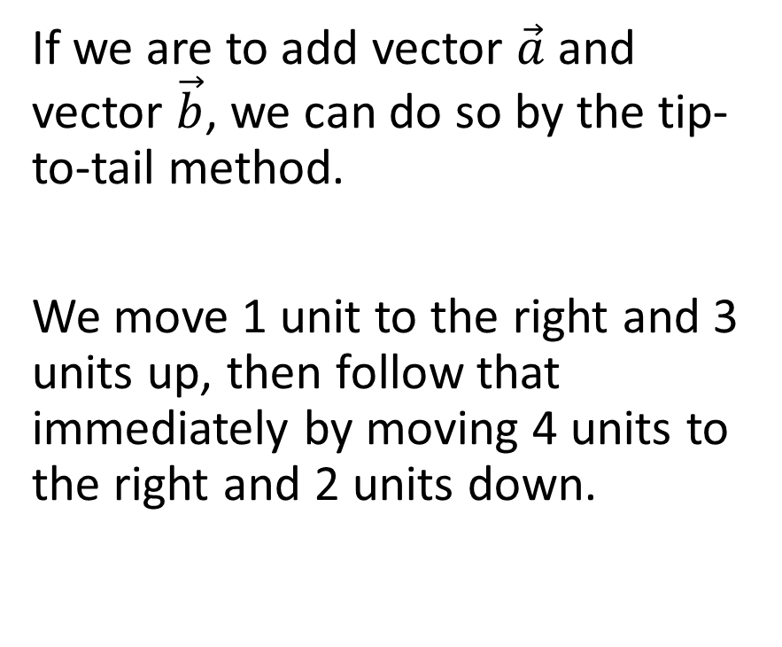
b)
If we are to add vector $\vec{a}$ and vector $\vec{b}$, we can do so by the tip-to-tail method.
We move 1 unit to the right and 3 units up, then follow that immediately by moving 4 units to the right and 2 units down.

Slide 10
b)
When we follow this process, the net effect is to move 5 units to the right and 1 unit up.

Slide 11
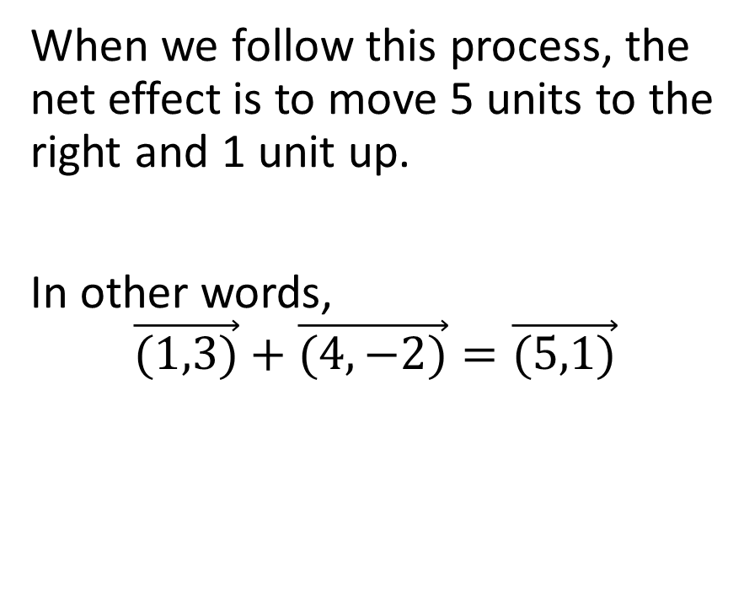
b)
When we follow this process, the net effect is to move 5 units to the right and 1 unit up.
In other words,
$$\vec{(1,3)}+\vec{(4,−2)}=\vec{(5,1)}$$

Slide 12
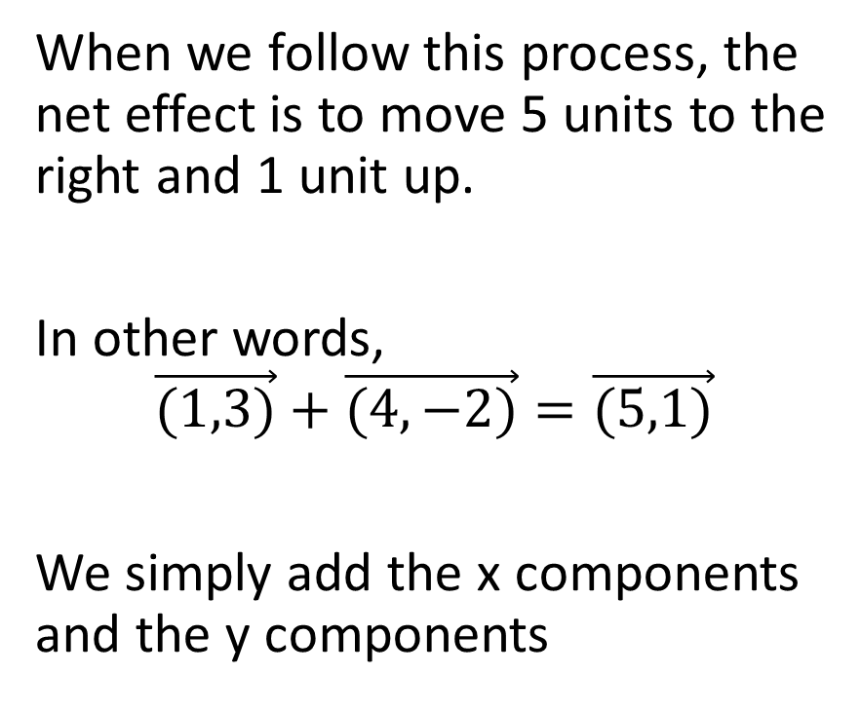
b)
When we follow this process, the net effect is to move 5 units to the right and 1 unit up.
In other words,
$$\vec{(1,3)}+\vec{(4,−2)}=\vec{(5,1)}$$
We simply add the x components and the y components

Slide 13
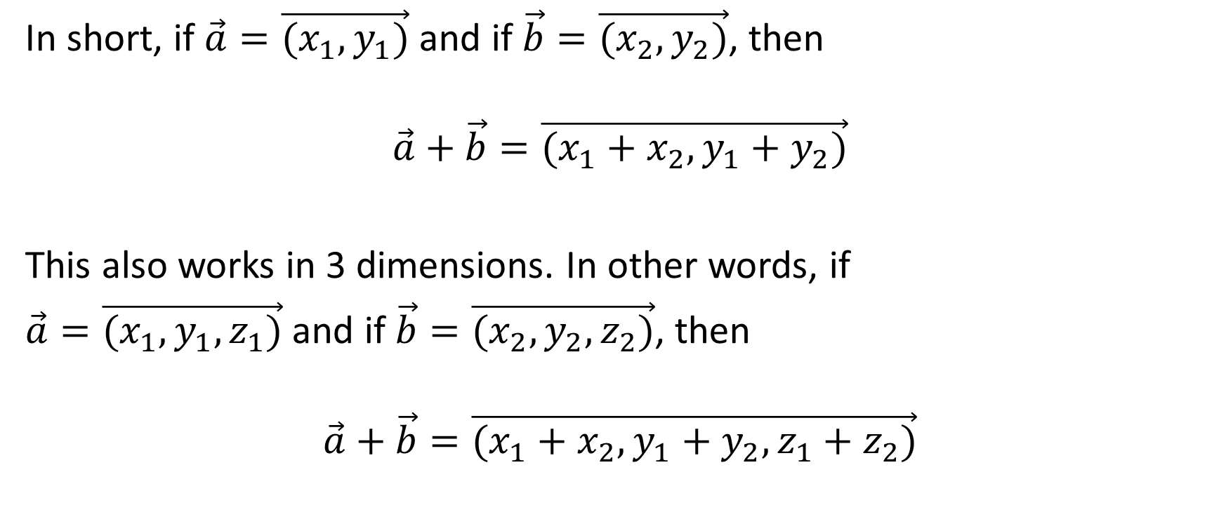
In short, if $\vec{a}=\vec{(x_{1},y_{1})}$ and if $\vec{b}=\vec{(x_{2},y_{2})}$, then
$$\vec{a}+\vec{b}=\vec{(x_{1}+x_{2},y_{1}+y_{2})}$$
This also works in 3 dimensions. In other words, if
$\vec{a}=\vec{(x_{1},y_{1},z_{1})}$ and if $\vec{b}=\vec{(x_{2},y_{2},z_{2})}$, then
$$\vec{a}+\vec{b}=\vec{(x_{1}+x_{2},y_{1}+y_{2},z_{1}+z_{2})}$$

Slide 14
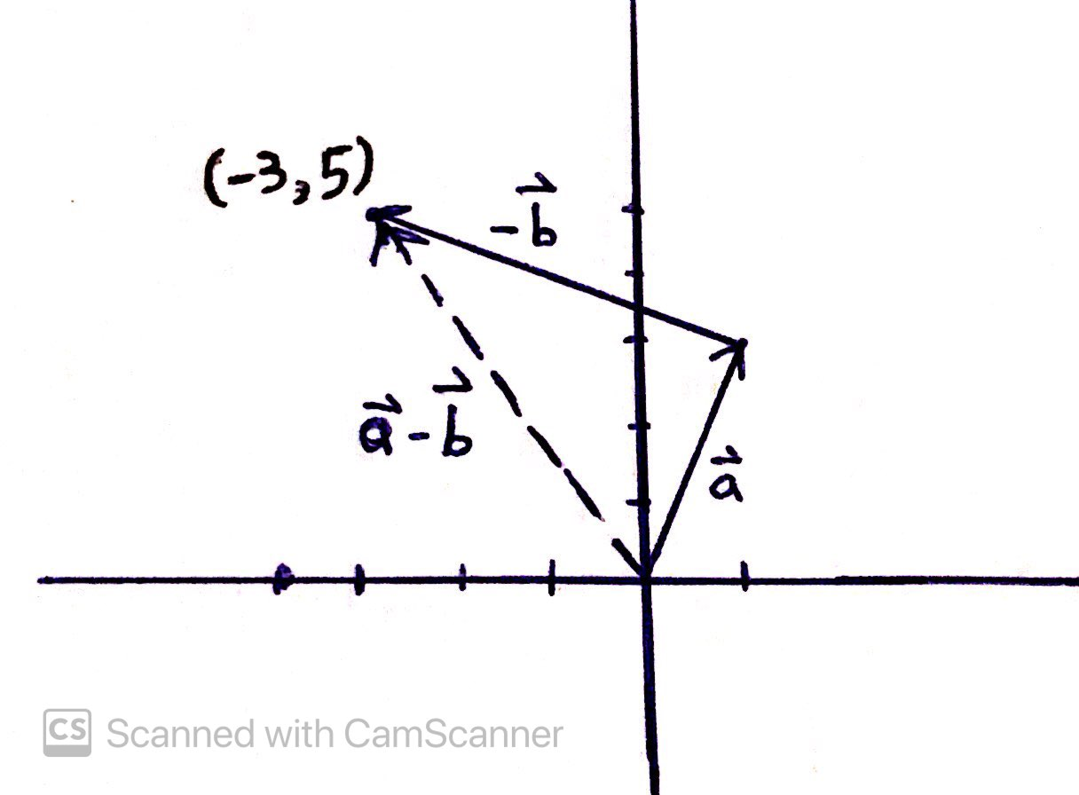
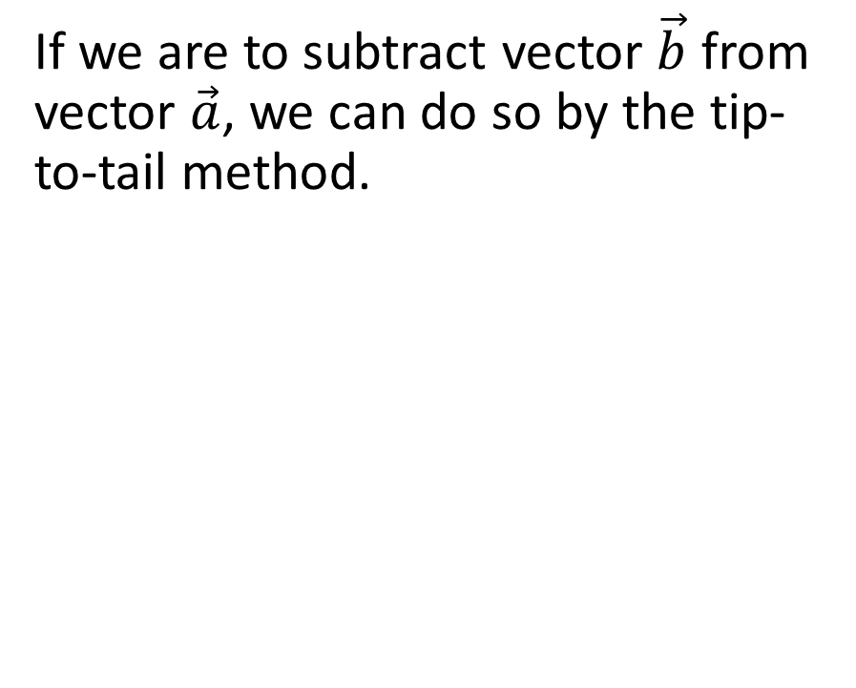
c)
If we are to subtract vector $\vec{b}$ from vector $\vec{a}$, we can do so by the tip-to-tail method.

Slide 15
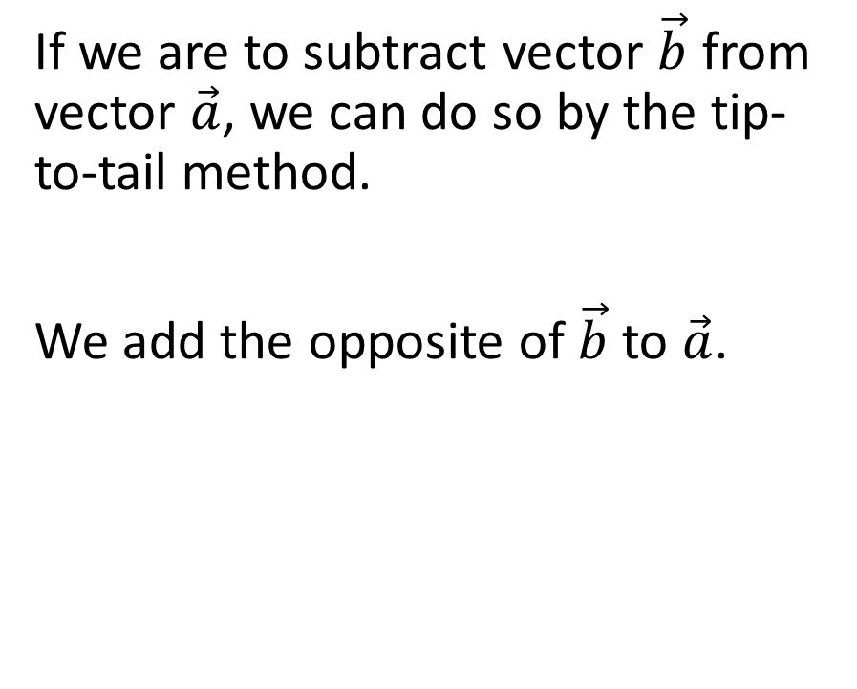
c)
If we are to subtract vector $\vec{b}$ from vector $\vec{a}$, we can do so by the tip-to-tail method.
We add the opposite of $\vec{b}$ to $\vec{a}$.

Slide 16
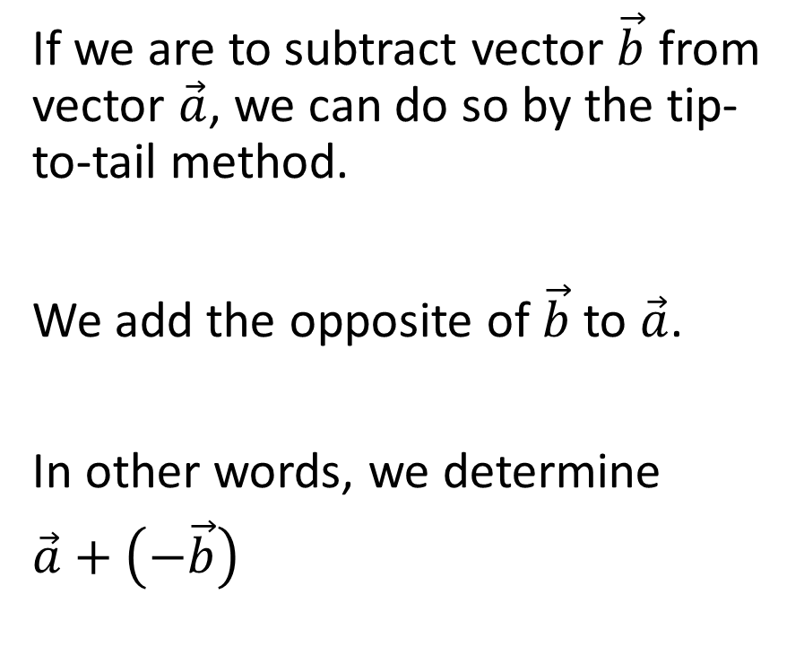
c)
If we are to subtract vector $\vec{b}$ from vector $\vec{a}$, we can do so by the tip-to-tail method.
We add the opposite of $\vec{b}$ to $\vec{a}$.
In other words, we determine
$\vec{a}+\left(−\vec{b}\right)$

Slide 17
c)
We move 1 unit to the right and 3 units up, then follow that immediately by moving 4 units to the left and 2 units up.

Slide 18
c)
We move 1 unit to the right and 3 units up, then follow that immediately by moving 4 units to the left and 2 units up.
When we follow this process, the net effect is to move 3 units to the left and 5 units up.

Slide 19

c)
In other words,
$$\vec{(1,3)}−\vec{(4,−2)}=\vec{(−3,5)}$$

Slide 20
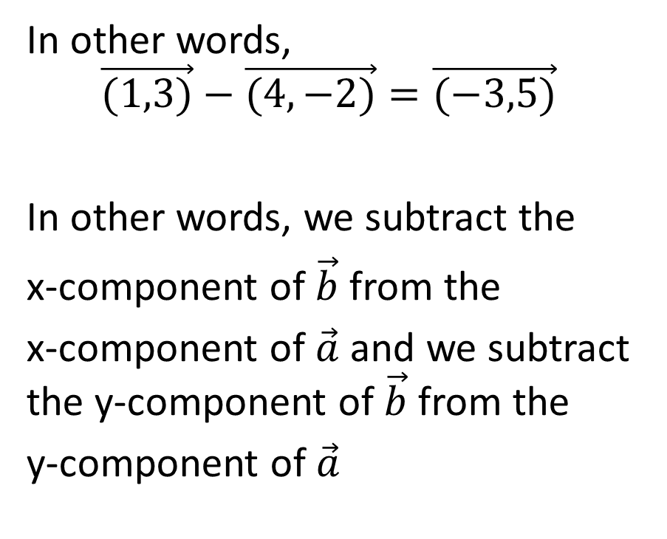
c)
In other words,
$$\vec{(1,3)}−\vec{(4,−2)}=\vec{(−3,5)}$$
In other words, we subtract the
x-component of $\vec{b}$ from the
x-component of $\vec{a}$ and we subtract the y-component of $\vec{b}$ from the
y-component of $\vec{a}$

Slide 21
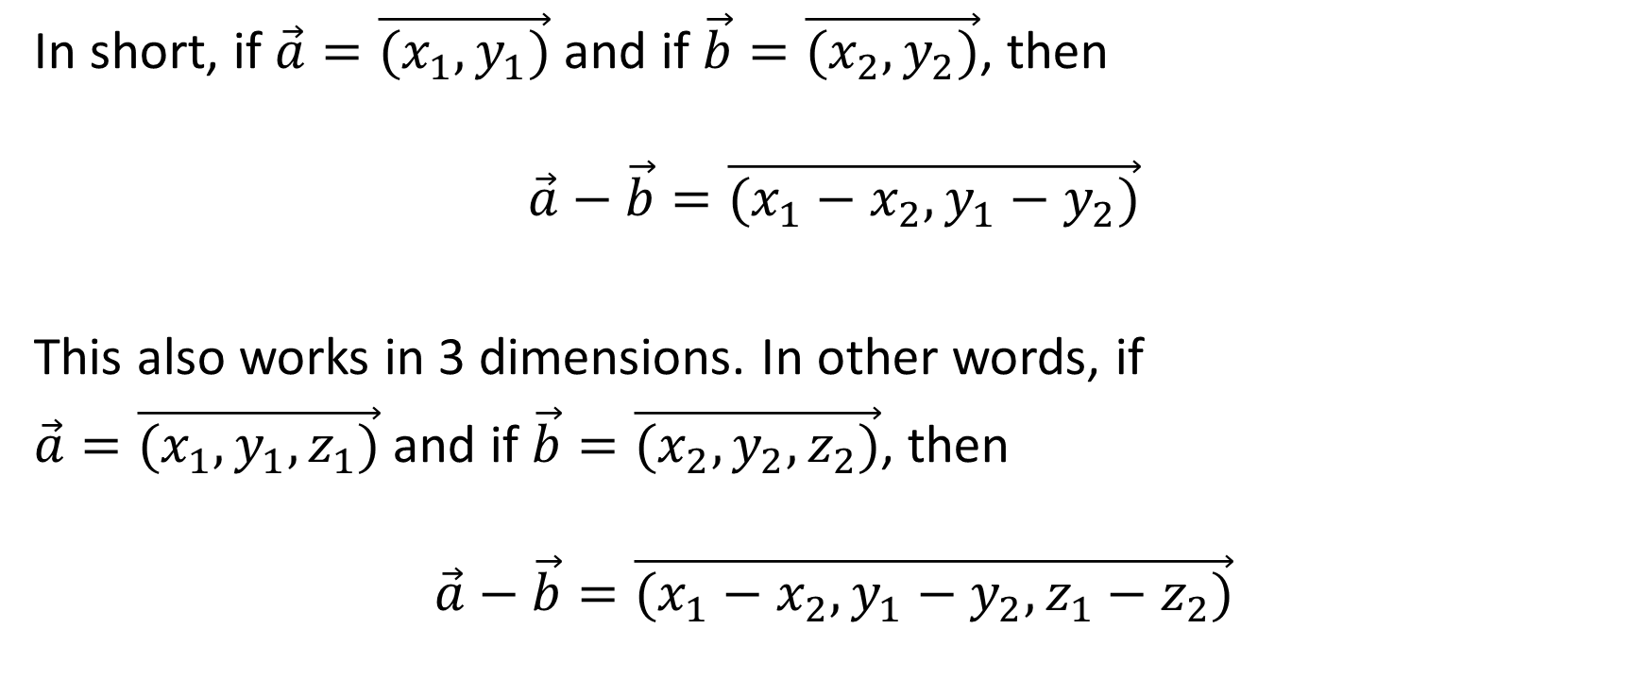
In short, if $\vec{a}=\vec{(x_{1},y_{1})}$ and if $\vec{b}=\vec{(x_{2},y_{2})}$, then
$$\vec{a}−\vec{b}=\vec{(x_{1}−x_{2},y_{1}−y_{2})}$$
This also works in 3 dimensions. In other words, if
$\vec{a}=\vec{(x_{1},y_{1},z_{1})}$ and if $\vec{b}=\vec{(x_{2},y_{2},z_{2})}$, then
$$\vec{a}−\vec{b}=\vec{(x_{1}−x_{2},y_{1}−y_{2},z_{1}−z_{2})}$$

Slide 22
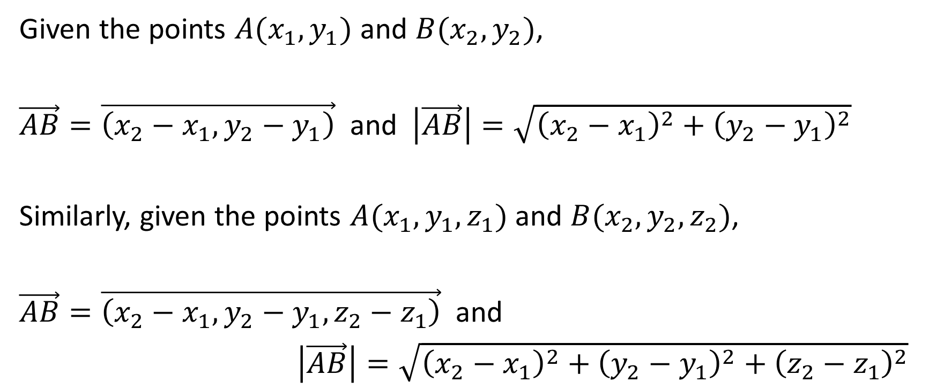
Components and Magnitudes from Point to Point
Given the points $A(x_{1},y_{1})$ and $B(x_{2},y_{2})$,
$\vec{AB}=\vec{\left(x_{2}−x_{1},y_{2}−y_{1}\right)}$ and $\left|\vec{AB}\right|=\sqrt{{\left(x_{2}−x_{1}\right)}^{2}+{\left(y_{2}−y_{1}\right)}^{2}}$
Similarly, given the points $A(x_{1},y_{1},z_{1})$ and $B(x_{2},y_{2},z_{2})$,
$\vec{AB}=\vec{\left(x_{2}−x_{1},y_{2}−y_{1},z_{2}−z_{1}\right)}$ and
$\left|\vec{AB}\right|=\sqrt{{\left(x_{2}−x_{1}\right)}^{2}+{\left(y_{2}−y_{1}\right)}^{2}+{\left(z_{2}−z_{1}\right)}^{2}}$

Slide 23
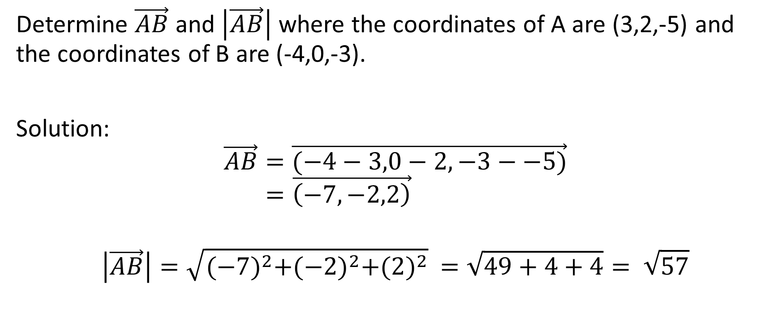
Example
Determine $\vec{AB}$ and $\left|\vec{AB}\right|$ where the coordinates of A are (3,2,-5) and the coordinates of B are (-4,0,-3).
Solution:
$$\vec{AB}=\vec{(−4−3,0−2,−3−−5)}$$
$$=\vec{\left(−7,−2,2\right)}$$
$$\left|\vec{AB}\right|=\sqrt{{(−7)}^{2}+{(−2)}^{2}+{(2)}^{2}} =\sqrt{49+4+4}= \sqrt{57}$$

Slide 24
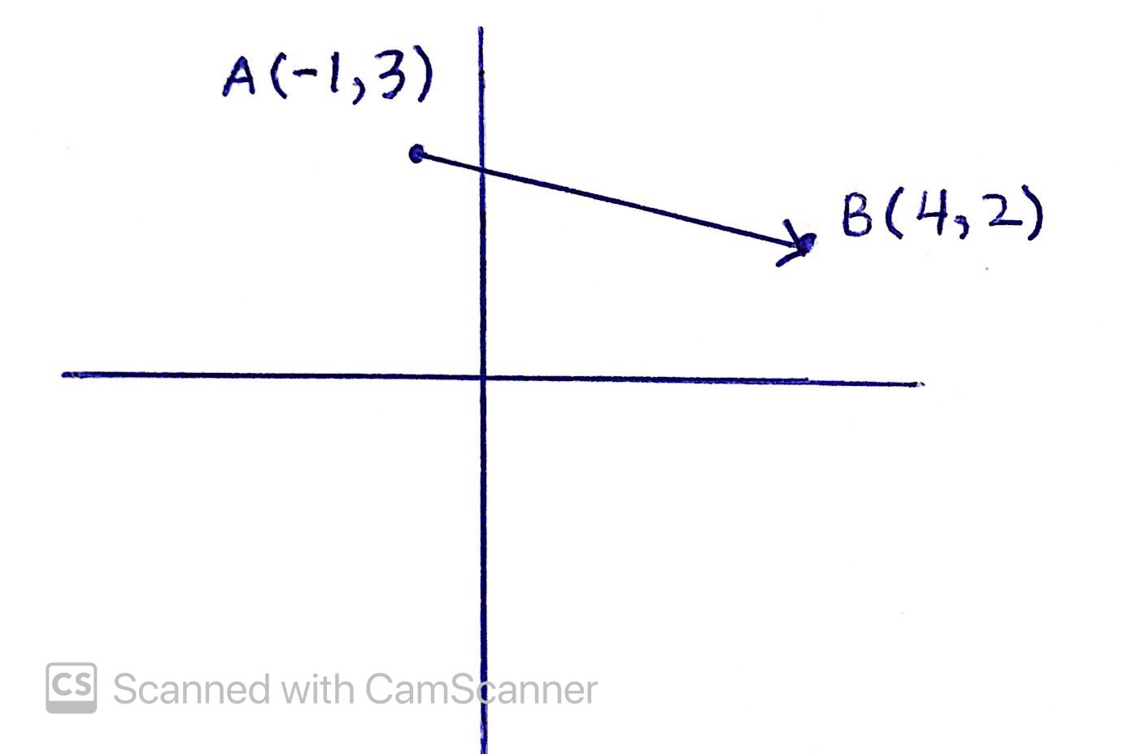
Example
For the vector shown at the right, determine the components of the position vector.

Slide 25
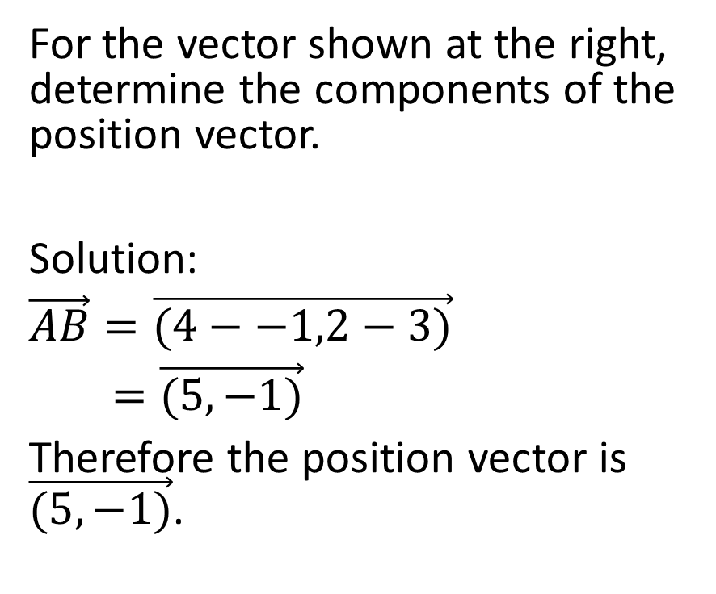
For the vector shown at the right, determine the components of the position vector.
Solution:
$\vec{AB}=\vec{(4−−1,2−3)}$
$=\vec{(5,−1)}$
Therefore the position vector is $\vec{(5,−1)}$.

Slide 26
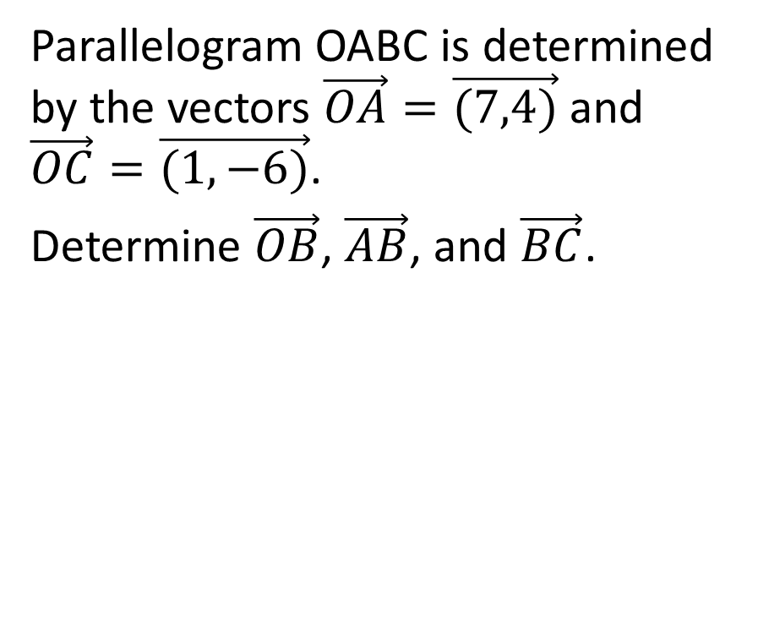
Example:
Parallelogram OABC is determined by the vectors $\vec{OA}=\vec{(7,4)}$ and $\vec{OC}=\vec{(1,−6)}$.
Determine $\vec{OB}$, $\vec{AB}$, and $\vec{BC}$.

Slide 27
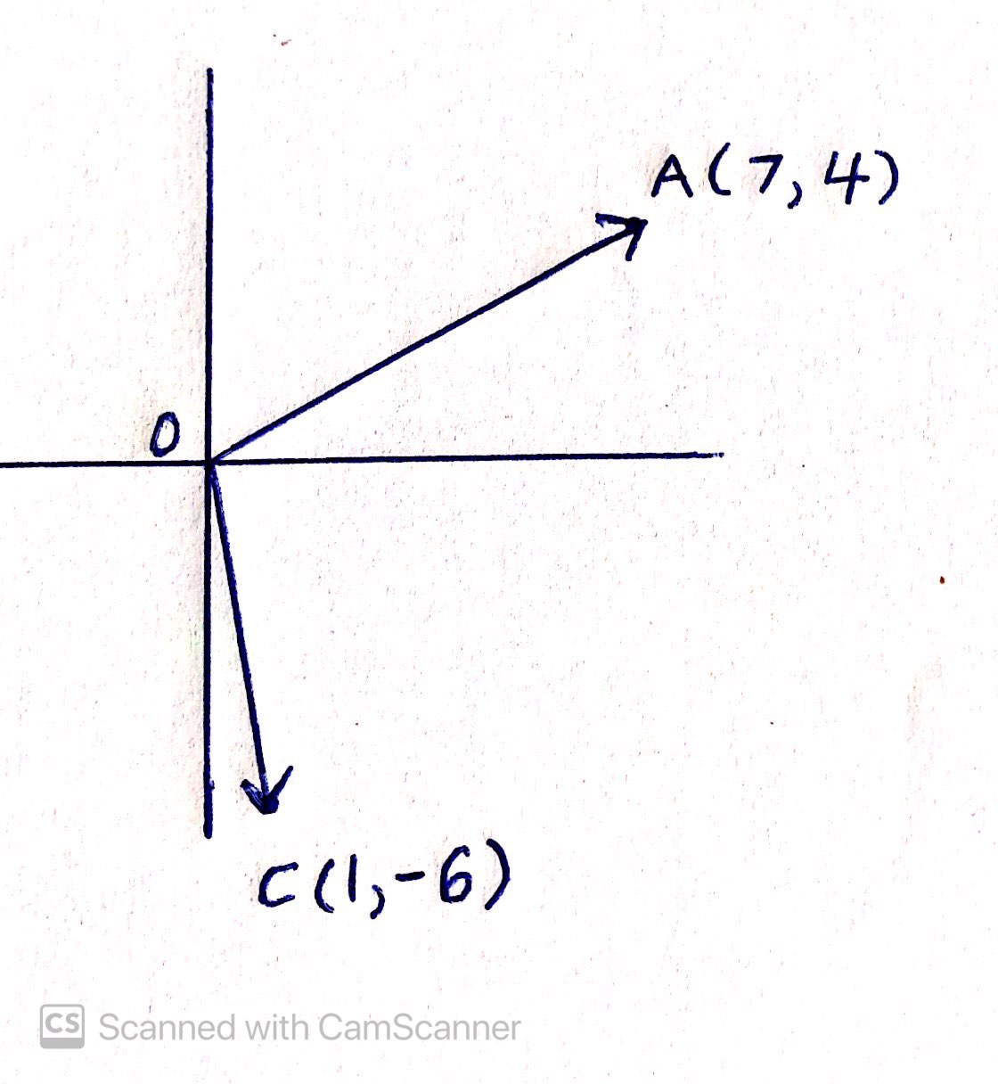
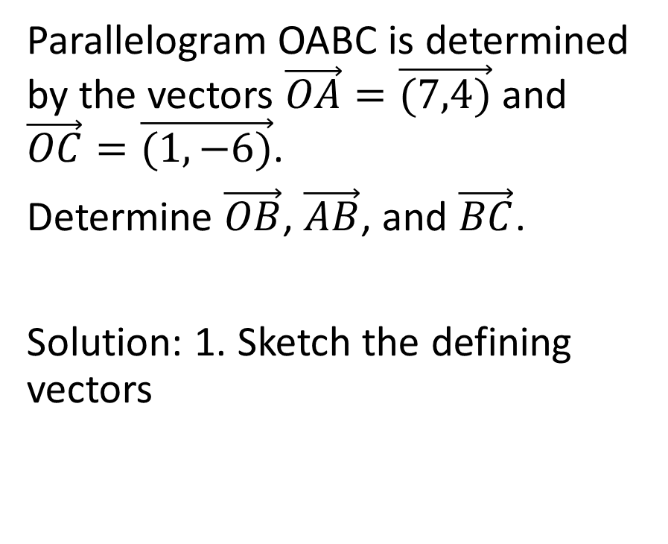
Parallelogram OABC is determined by the vectors $\vec{OA}=\vec{(7,4)}$ and $\vec{OC}=\vec{(1,−6)}$.
Determine $\vec{OB}$, $\vec{AB}$, and $\vec{BC}$.
Solution: 1. Sketch the defining vectors

Slide 28
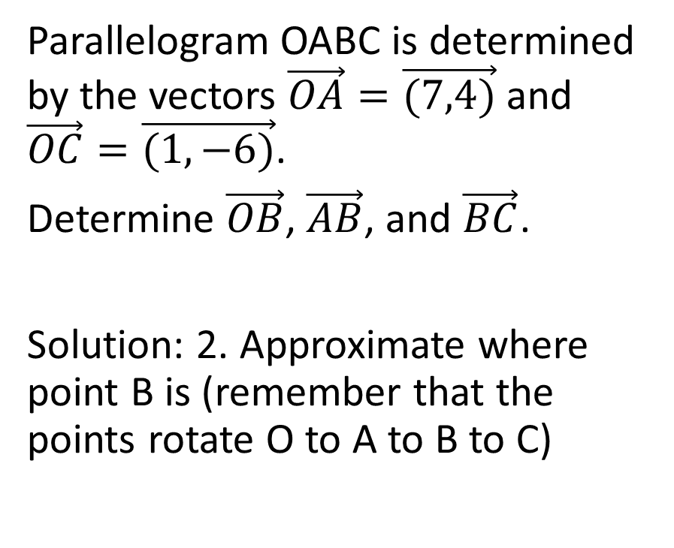
Parallelogram OABC is determined by the vectors $\vec{OA}=\vec{(7,4)}$ and $\vec{OC}=\vec{(1,−6)}$.
Determine $\vec{OB}$, $\vec{AB}$, and $\vec{BC}$.
Solution: 2. Approximate where point B is (remember that the points rotate O to A to B to C)

Slide 29
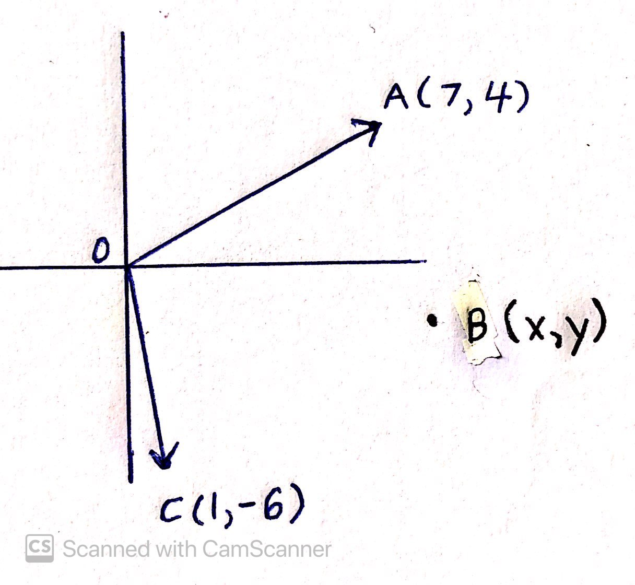
Parallelogram OABC is determined by the vectors $\vec{OA}=\vec{(7,4)}$ and $\vec{OC}=\vec{(1,−6)}$.
Determine $\vec{OB}$, $\vec{AB}$, and $\vec{BC}$.
Solution: 2. Approximate where point B is (remember that the points rotate O to A to B to C)

Slide 30
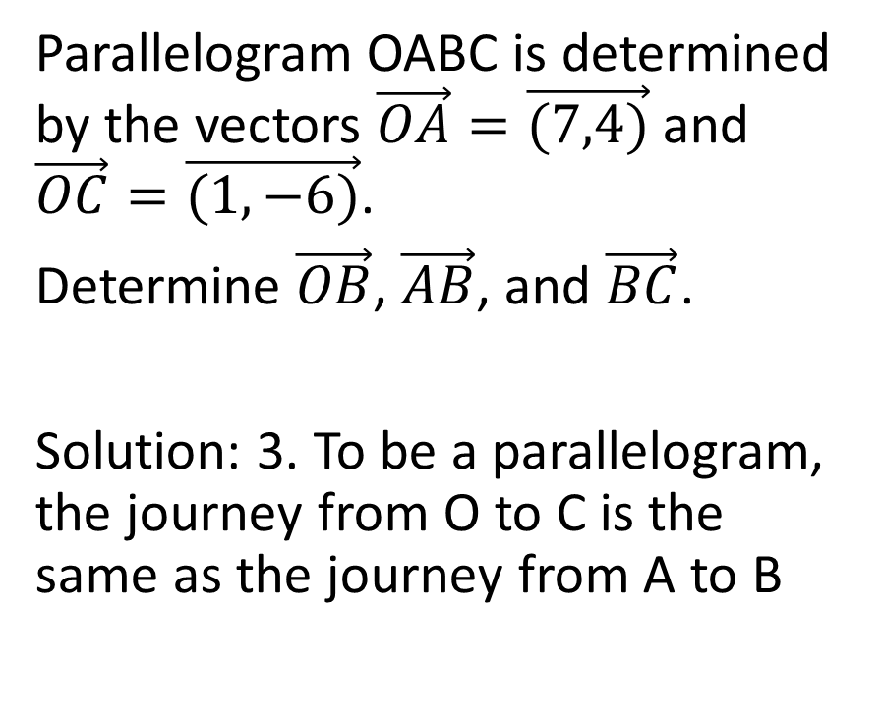
Parallelogram OABC is determined by the vectors $\vec{OA}=\vec{(7,4)}$ and $\vec{OC}=\vec{(1,−6)}$.
Determine $\vec{OB}$, $\vec{AB}$, and $\vec{BC}$.
Solution: 3. To be a parallelogram, the journey from O to C is the same as the journey from A to B

Slide 31
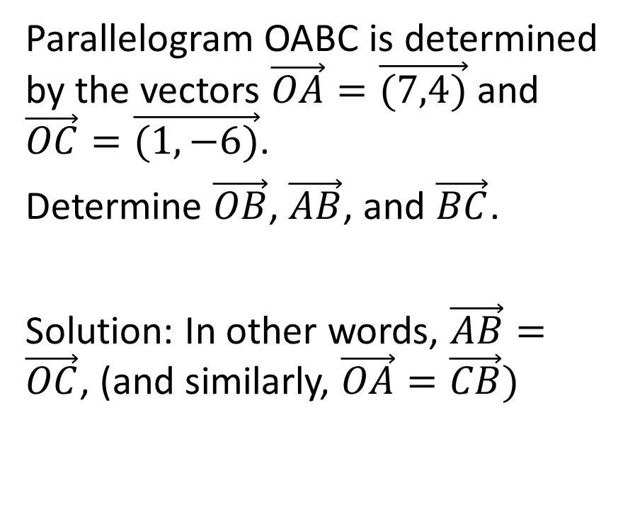
Parallelogram OABC is determined by the vectors $\vec{OA}=\vec{(7,4)}$ and $\vec{OC}=\vec{(1,−6)}$.
Determine $\vec{OB}$, $\vec{AB}$, and $\vec{BC}$.
Solution: In other words, $\vec{AB}=\vec{OC}$, (and similarly, $\vec{OA}=\vec{CB})$

Slide 32
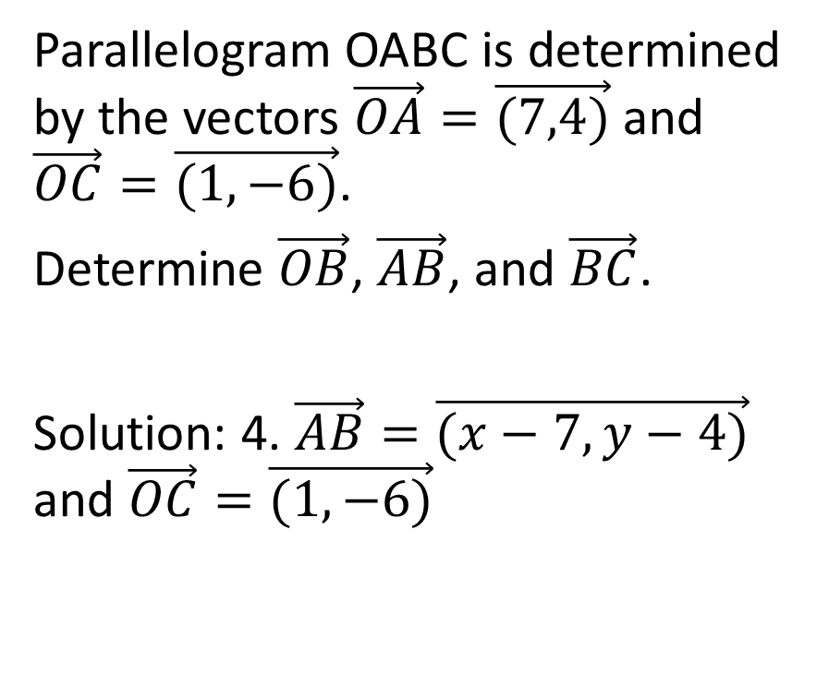
Parallelogram OABC is determined by the vectors $\vec{OA}=\vec{(7,4)}$ and $\vec{OC}=\vec{(1,−6)}$.
Determine $\vec{OB}$, $\vec{AB}$, and $\vec{BC}$.
Solution: 4. $\vec{AB}=\vec{(x−7,y−4)}$ and $\vec{OC}=\vec{(1,−6)}$

Slide 33
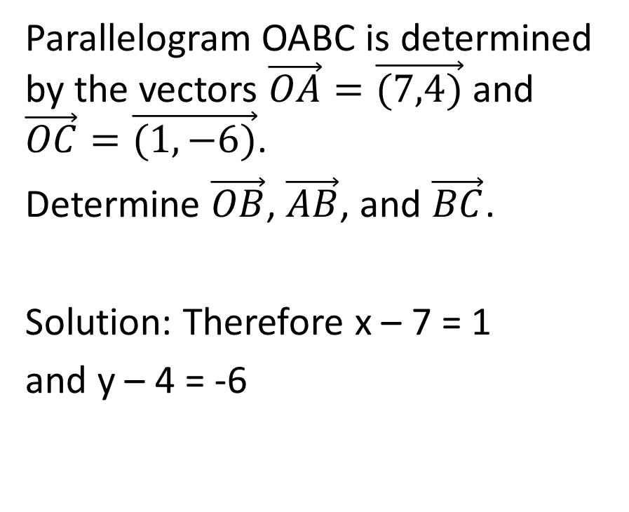
Parallelogram OABC is determined by the vectors $\vec{OA}=\vec{(7,4)}$ and $\vec{OC}=\vec{(1,−6)}$.
Determine $\vec{OB}$, $\vec{AB}$, and $\vec{BC}$.
Solution: Therefore x – 7 = 1
and y – 4 = -6

Slide 34
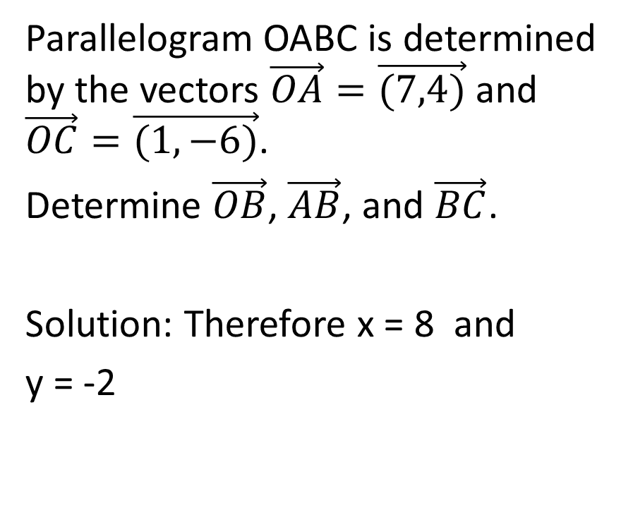
Parallelogram OABC is determined by the vectors $\vec{OA}=\vec{(7,4)}$ and $\vec{OC}=\vec{(1,−6)}$.
Determine $\vec{OB}$, $\vec{AB}$, and $\vec{BC}$.
Solution: Therefore x = 8 and
y = -2

Slide 35
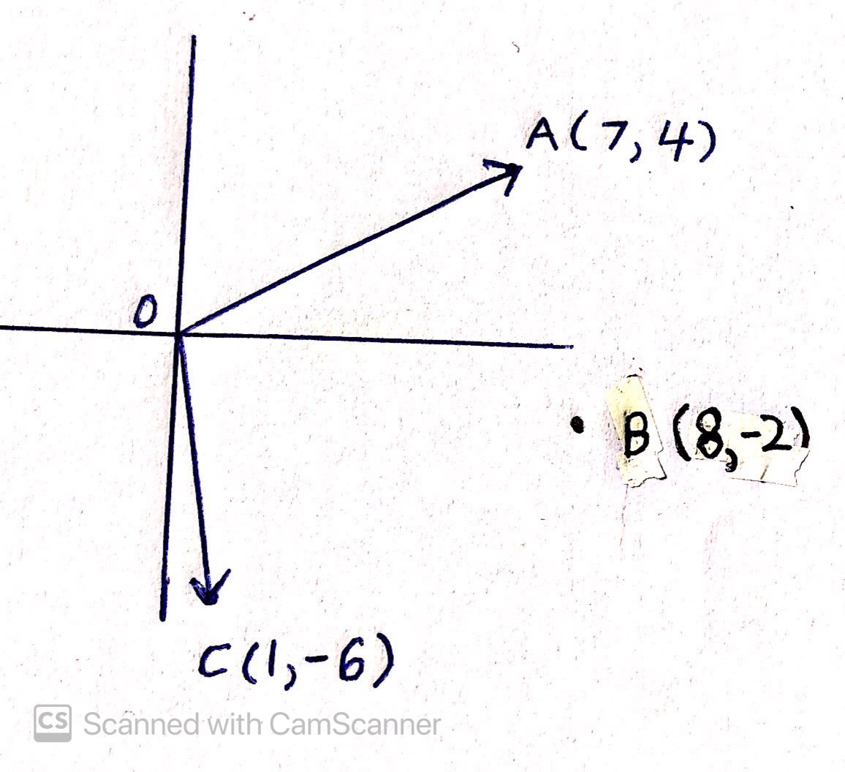
Parallelogram OABC is determined by the vectors $\vec{OA}=\vec{(7,4)}$ and $\vec{OC}=\vec{(1,−6)}$.
Determine $\vec{OB}$, $\vec{AB}$, and $\vec{BC}$.
Solution: Therefore x = 8 and
y = -2

Slide 36
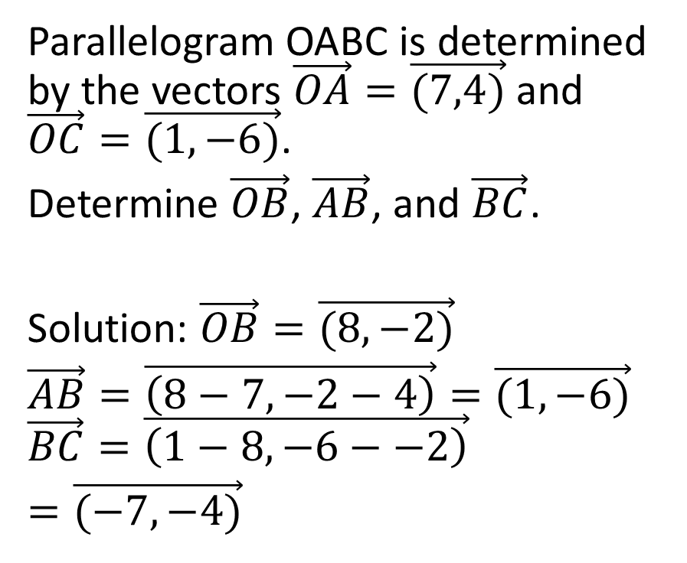
Parallelogram OABC is determined by the vectors $\vec{OA}=\vec{(7,4)}$ and $\vec{OC}=\vec{(1,−6)}$.
Determine $\vec{OB}$, $\vec{AB}$, and $\vec{BC}$.
Solution: $\vec{OB}=\vec{(8,−2)}$
$\vec{AB}=\vec{\left(8−7,−2−4\right)}=\vec{(1,−6)}$ $\vec{BC}=\vec{\left(1−8,−6−−2\right)}$
$=\vec{(−7,−4)}$

Slide 37
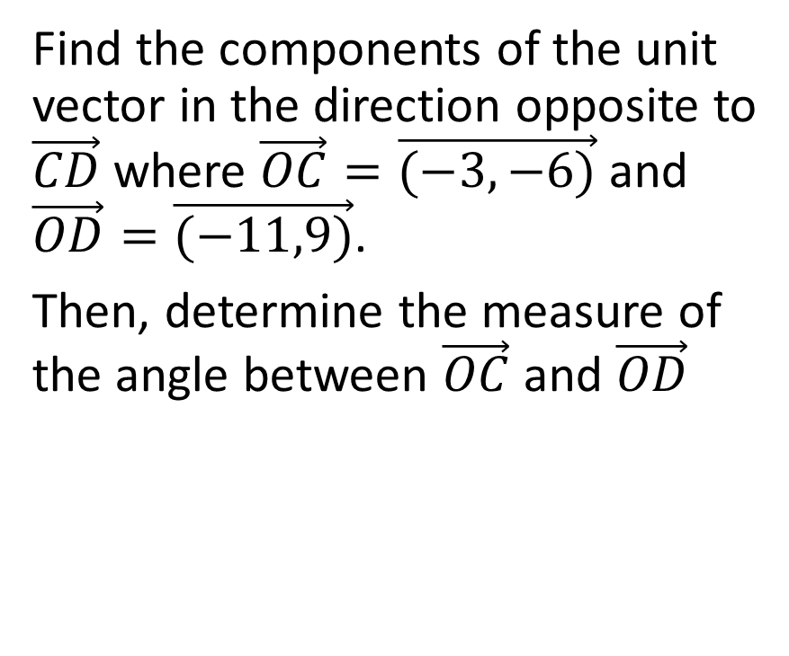
Example:
Find the components of the unit vector in the direction opposite to $\vec{CD}$ where $\vec{OC}=\vec{(−3,−6)}$ and $\vec{OD}=\vec{(−11,9)}$.
Then, determine the measure of the angle between $\vec{OC}$ and $\vec{OD}$

Slide 38
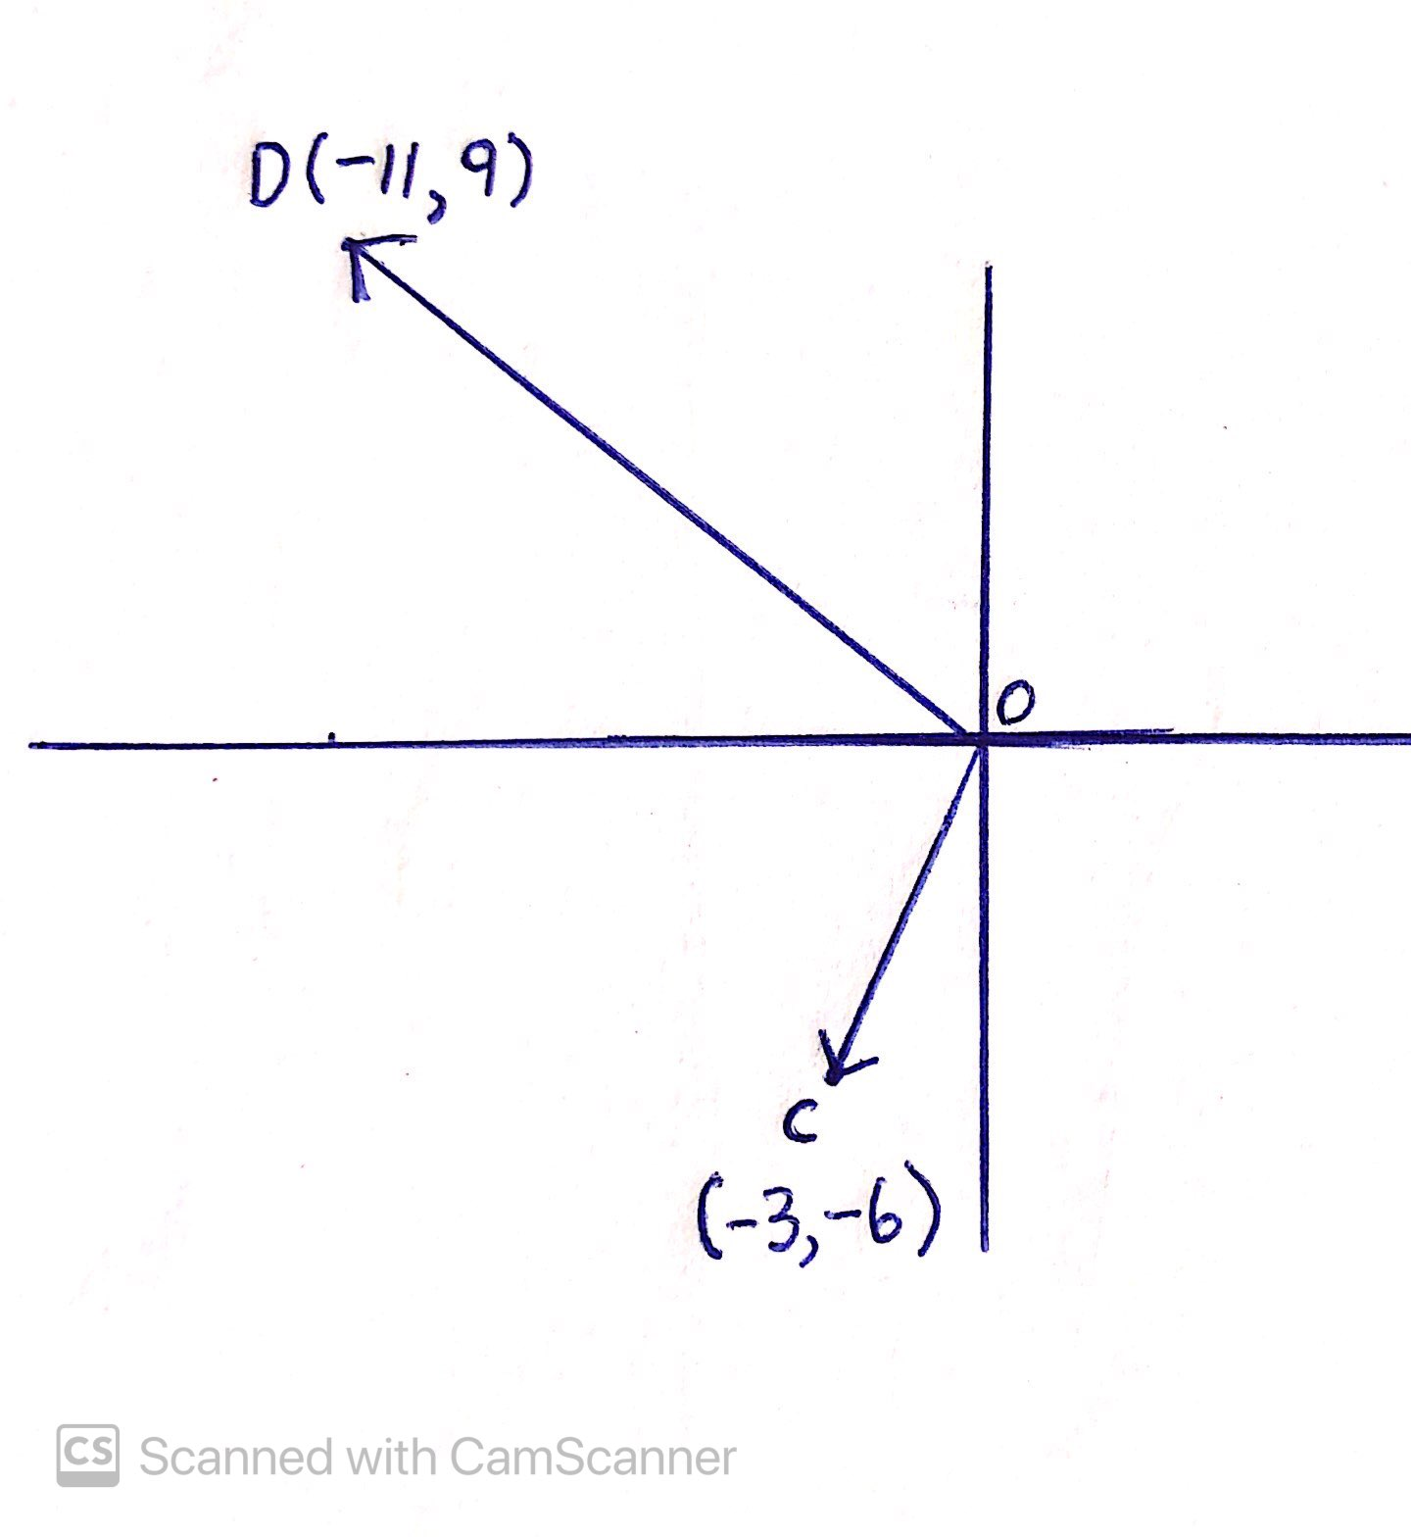
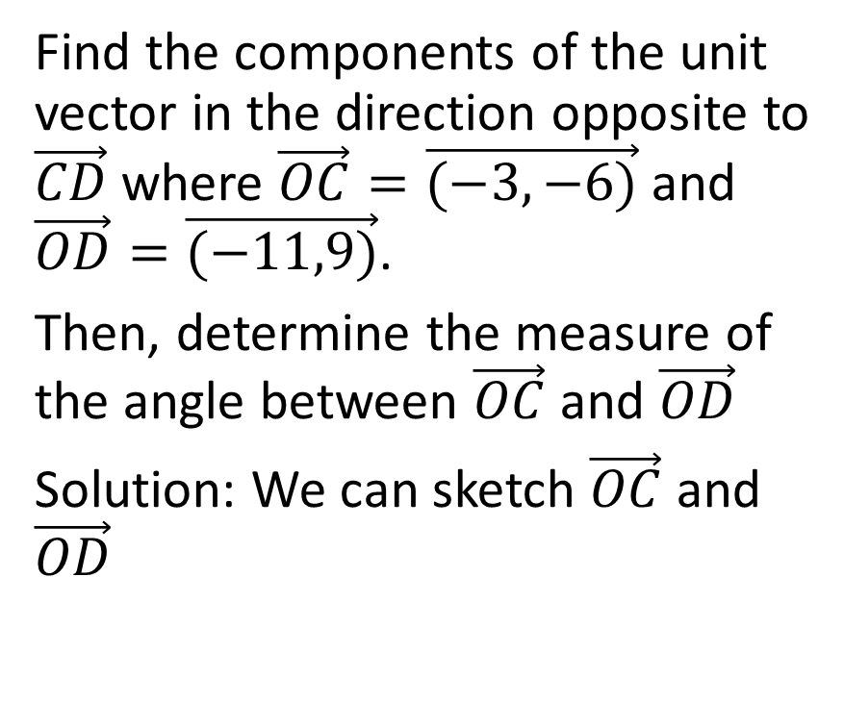
Find the components of the unit vector in the direction opposite to $\vec{CD}$ where $\vec{OC}=\vec{(−3,−6)}$ and $\vec{OD}=\vec{(−11,9)}$.
Then, determine the measure of the angle between $\vec{OC}$ and $\vec{OD}$
Solution: We can sketch $\vec{OC}$ and $\vec{OD}$

Slide 39
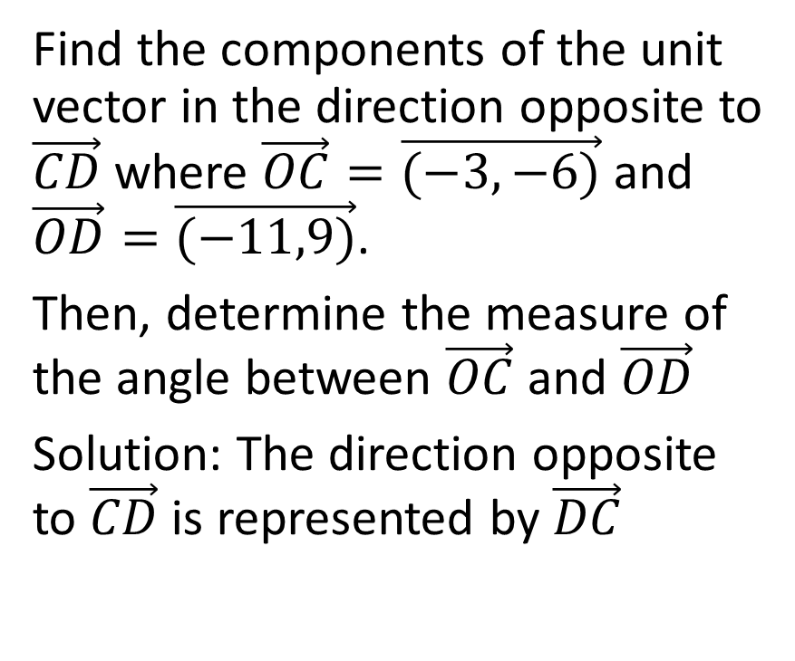
Find the components of the unit vector in the direction opposite to $\vec{CD}$ where $\vec{OC}=\vec{(−3,−6)}$ and $\vec{OD}=\vec{(−11,9)}$.
Then, determine the measure of the angle between $\vec{OC}$ and $\vec{OD}$
Solution: The direction opposite to $\vec{CD}$ is represented by $\vec{DC}$

Slide 40
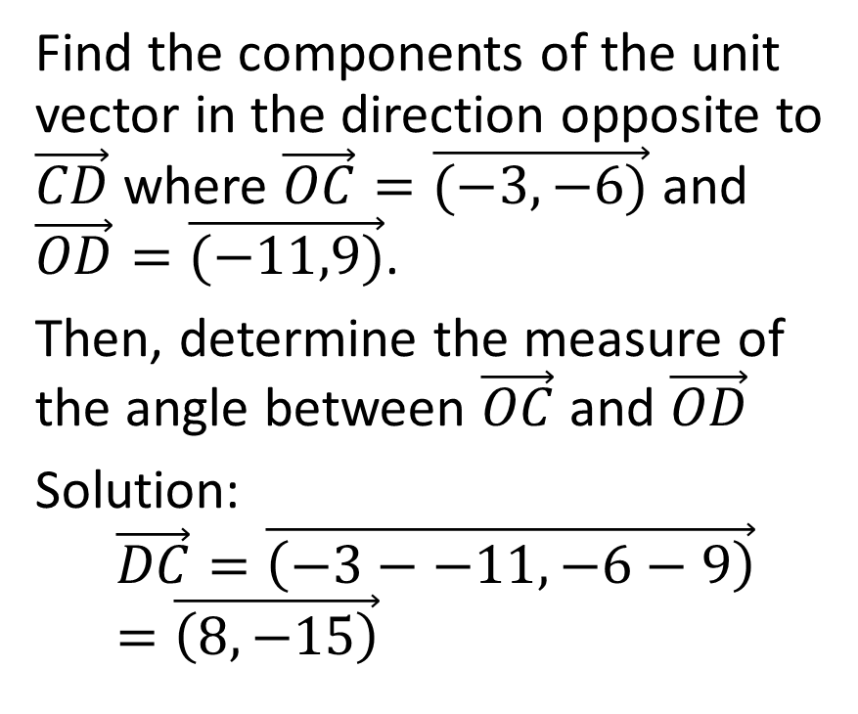
Find the components of the unit vector in the direction opposite to $\vec{CD}$ where $\vec{OC}=\vec{(−3,−6)}$ and $\vec{OD}=\vec{(−11,9)}$.
Then, determine the measure of the angle between $\vec{OC}$ and $\vec{OD}$
Solution:
$$\vec{DC}=\vec{\left(−3−−11,−6−9\right)}=\vec{\left(8,−15\right)}$$

Slide 41
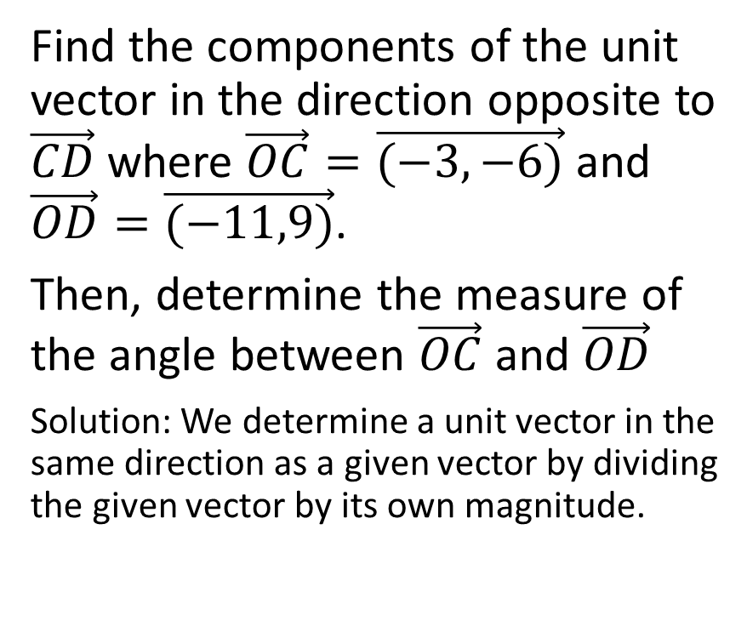
Find the components of the unit vector in the direction opposite to $\vec{CD}$ where $\vec{OC}=\vec{(−3,−6)}$ and $\vec{OD}=\vec{(−11,9)}$.
Then, determine the measure of the angle between $\vec{OC}$ and $\vec{OD}$
Solution: We determine a unit vector in the same direction as a given vector by dividing the given vector by its own magnitude.

Slide 42
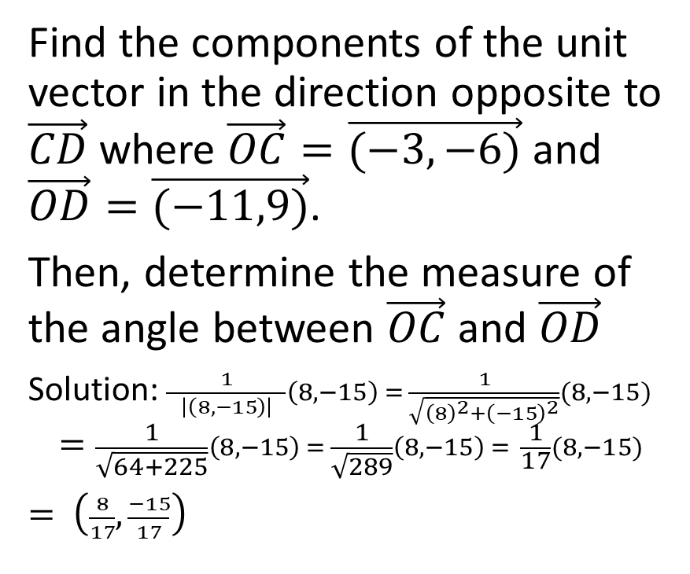
Find the components of the unit vector in the direction opposite to $\vec{CD}$ where $\vec{OC}=\vec{(−3,−6)}$ and $\vec{OD}=\vec{(−11,9)}$.
Then, determine the measure of the angle between $\vec{OC}$ and $\vec{OD}$
Solution: $\frac{1}{ \left|\left(8,−15\right)\right| }\left(8,−15\right) = \frac{1}{\sqrt{{\left(8\right)}^{2}+{\left(−15\right)}^{2}}}(8,−15)$
$$=\frac{1}{\sqrt{64+225}}\left(8,−15\right) = \frac{1}{\sqrt{289}}\left(8,−15\right) = \frac{1}{17}(8,−15)$$
$= \left(\frac{8}{17},\frac{−15}{17}\right)$

Slide 43
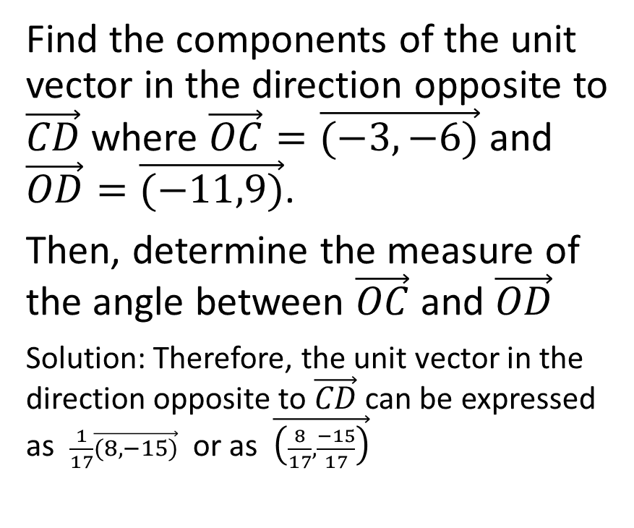
Find the components of the unit vector in the direction opposite to $\vec{CD}$ where $\vec{OC}=\vec{(−3,−6)}$ and $\vec{OD}=\vec{(−11,9)}$.
Then, determine the measure of the angle between $\vec{OC}$ and $\vec{OD}$
Solution: Therefore, the unit vector in the direction opposite to $\vec{CD}$ can be expressed as $\frac{1}{17}\vec{(8,−15)}$ or as $\vec{\left(\frac{8}{17},\frac{−15}{17}\right)}$

Slide 44
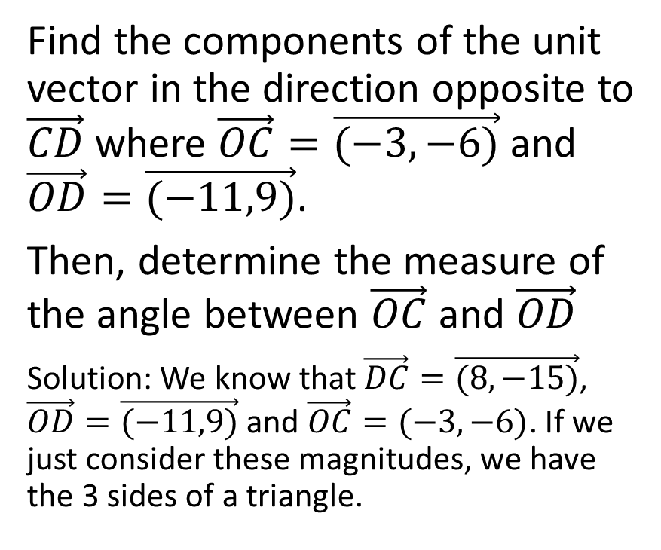
Find the components of the unit vector in the direction opposite to $\vec{CD}$ where $\vec{OC}=\vec{(−3,−6)}$ and $\vec{OD}=\vec{(−11,9)}$.
Then, determine the measure of the angle between $\vec{OC}$ and $\vec{OD}$
Solution: We know that $\vec{DC}=\vec{(8,−15)}$, $\vec{OD}=\vec{(−11,9)}$ and $\vec{OC}=(−3,−6)$. If we just consider these magnitudes, we have the 3 sides of a triangle.

Slide 45
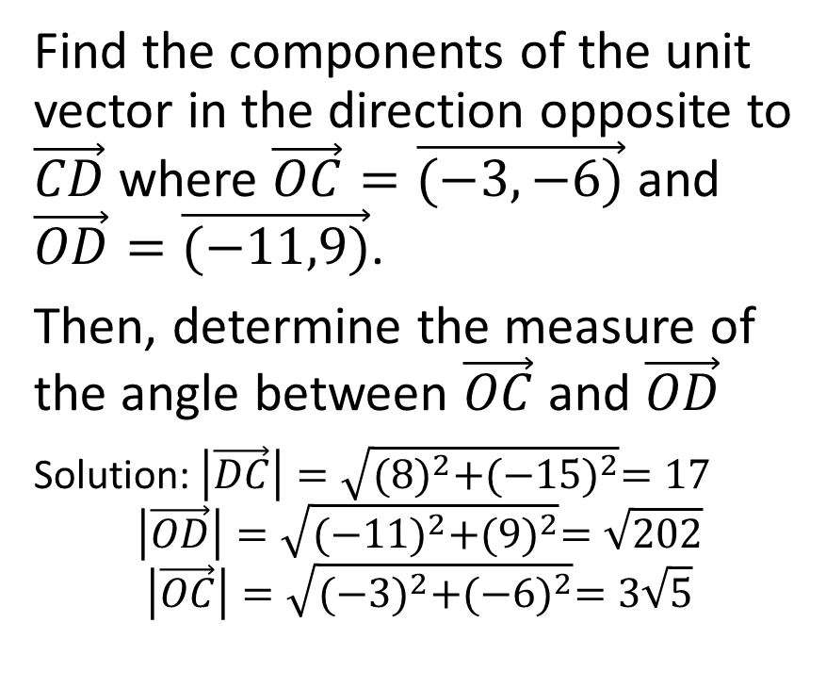
Find the components of the unit vector in the direction opposite to $\vec{CD}$ where $\vec{OC}=\vec{(−3,−6)}$ and $\vec{OD}=\vec{(−11,9)}$.
Then, determine the measure of the angle between $\vec{OC}$ and $\vec{OD}$
Solution: $\left|\vec{DC}\right|=\sqrt{{(8)}^{2}+{(−15)}^{2}}=17$
$$\left|\vec{OD}\right|=\sqrt{{(−11)}^{2}+{(9)}^{2}}=\sqrt{202}$$
$$\left|\vec{OC}\right|=\sqrt{{(−3)}^{2}+{(−6)}^{2}}=3\sqrt{5}$$

Slide 46
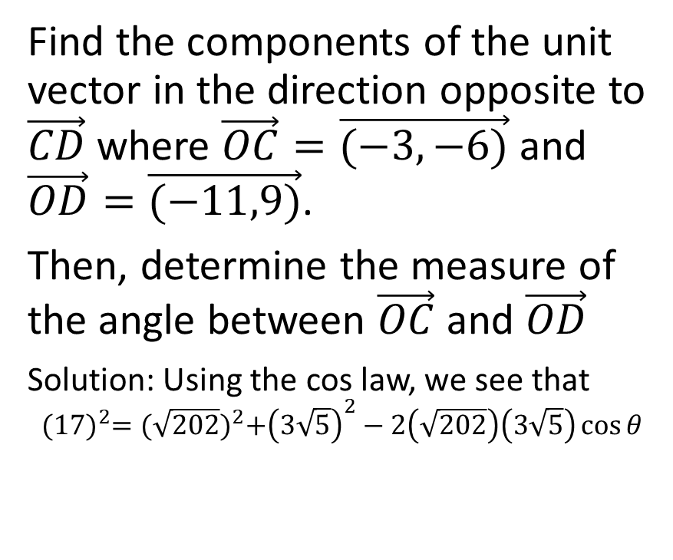
Find the components of the unit vector in the direction opposite to $\vec{CD}$ where $\vec{OC}=\vec{(−3,−6)}$ and $\vec{OD}=\vec{(−11,9)}$.
Then, determine the measure of the angle between $\vec{OC}$ and $\vec{OD}$
Solution: Using the cos law, we see that
$${(17)}^{2}={(\sqrt{202})}^{2}+{\left(3\sqrt{5}\right)}^{2}−2\left(\sqrt{202}\right)\left(3\sqrt{5}\right)\cos{θ}$$

Slide 47
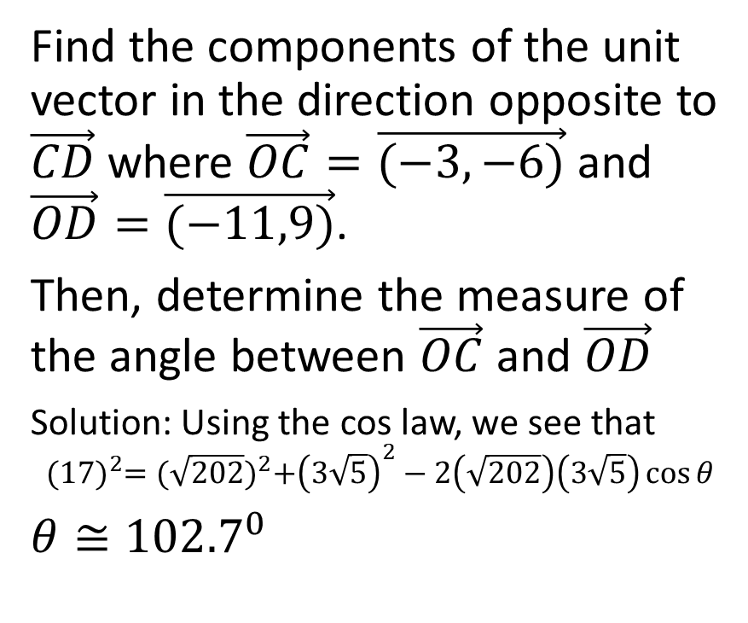
Find the components of the unit vector in the direction opposite to $\vec{CD}$ where $\vec{OC}=\vec{(−3,−6)}$ and $\vec{OD}=\vec{(−11,9)}$.
Then, determine the measure of the angle between $\vec{OC}$ and $\vec{OD}$
Solution: Using the cos law, we see that
$${(17)}^{2}={(\sqrt{202})}^{2}+{\left(3\sqrt{5}\right)}^{2}−2\left(\sqrt{202}\right)\left(3\sqrt{5}\right)\cos{θ}$$
$θ≅{102.7}^{0}$

Slide 48
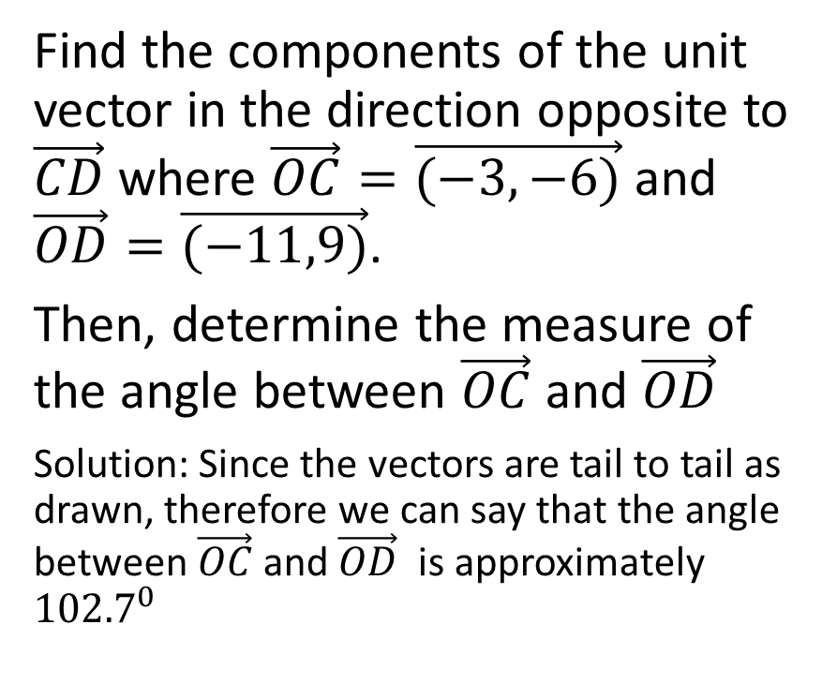
Find the components of the unit vector in the direction opposite to $\vec{CD}$ where $\vec{OC}=\vec{(−3,−6)}$ and $\vec{OD}=\vec{(−11,9)}$.
Then, determine the measure of the angle between $\vec{OC}$ and $\vec{OD}$
Solution: Since the vectors are tail to tail as drawn, therefore we can say that the angle between $\vec{OC}$ and $\vec{OD}$ is approximately ${102.7}^{0}$

Slide 49

Example:
If $\vec{u}=−2\vec{i}+9\vec{j}+6\vec{k}$, and if
$\vec{v}=\vec{i}−\vec{j}+\vec{k}$, determine $3\vec{u}−2\vec{v}$ and $\left|3\vec{u}−2\vec{v}\right|$

Slide 50

If $\vec{u}=−2\vec{i}+9\vec{j}+6\vec{k}$, and if
$\vec{v}=\vec{i}−\vec{j}+\vec{k}$, determine $3\vec{u}−2\vec{v}$ and $\left|3\vec{u}−2\vec{v}\right|$
Solution:
$3\vec{u}−2\vec{v}$
= $3\left(−2\vec{i}+9\vec{j}+6\vec{k}\right)−2\left(\vec{i}−\vec{j}+\vec{k}\right)$
$=−6\vec{i}+27\vec{j}+18\vec{k}−2\vec{i}+2\vec{j}−2\vec{k}$
$=−8\vec{i}+29\vec{j}+16\vec{k}$

Slide 51

If $\vec{u}=−2\vec{i}+9\vec{j}+6\vec{k}$, and if
$\vec{v}=\vec{i}−\vec{j}+\vec{k}$, determine $3\vec{u}−2\vec{v}$ and $\left|3\vec{u}−2\vec{v}\right|$
Solution:
$3\vec{u}−2\vec{v}$
= $3\left(−2\vec{i}+9\vec{j}+6\vec{k}\right)−2\left(\vec{i}−\vec{j}+\vec{k}\right)$
$=−6\vec{i}+27\vec{j}+18\vec{k}−2\vec{i}+2\vec{j}−2\vec{k}$
$=−8\vec{i}+29\vec{j}+16\vec{k}$
$\left|3\vec{u}−2\vec{v}\right|=\sqrt{{(−8)}^{2}+{(29)}^{2}+{(16)}^{2}}$
$=\sqrt{64+841+256}$
$=\sqrt{1181}$

Slide 52

Example:
A parallelepiped is formed by the vectors $\vec{OA}=\vec{(3,−1,4)}$,
$\vec{OB}=\vec{(−1,8,−7)},$and
$\vec{OC}=\vec{\left(4,0,−9\right)}$ .
Determine the coordinates of all the vertices for the parallelepiped.

Slide 53

A parallelepiped is formed by the vectors $\vec{OA}=\vec{(3,−1,4)}$,
$\vec{OB}=\vec{(−1,8,−7)},$and
$\vec{OC}=\vec{\left(4,0,−9\right)}$ .
Determine the coordinates of all the vertices for the parallelepiped.
Solution: A parallelepiped is a solid body of which each face is a parallelogram.

Slide 54

A parallelepiped is formed by the vectors $\vec{OA}=\vec{(3,−1,4)}$,
$\vec{OB}=\vec{(−1,8,−7)},$and
$\vec{OC}=\vec{\left(4,0,−9\right)}$ .
Determine the coordinates of all the vertices for the parallelepiped.
Solution: We can draw a diagram, but thankfully it does not need to be to scale. A cube will suffice.

Slide 55

A parallelepiped is formed by the vectors $\vec{OA}=\vec{(3,−1,4)}$,
$\vec{OB}=\vec{(−1,8,−7)},$and
$\vec{OC}=\vec{\left(4,0,−9\right)}$ .
Determine the coordinates of all the vertices for the parallelepiped.
Solution: We can draw a diagram, but thankfully it does not need to be to scale. A cube will suffice.
.

Slide 56



A parallelepiped is formed by the vectors $\vec{OA}=\vec{(3,−1,4)}$,
$\vec{OB}=\vec{(−1,8,−7)},$and
$\vec{OC}=\vec{\left(4,0,−9\right)}$ .
Determine the coordinates of all the vertices for the parallelepiped.
Solution: Choose one vertex to be O(0,0,0) and the three adjoining vertices are A, B and C.
.

Slide 57
It doesn’t have to be drawn to scale and you don’t need to worry about which direction represents positive or negative x-components, positive or negative y-components, or positive or negative z-components.
.

Slide 58
We can label the four remaining vertices.
.

Slide 59

We know that $\vec{OC}=\vec{AG}$ (same direction and magnitude)
Letting G have the coordinates $\left(g_{1},g_{2},g_{3}\right)$, we see that $\left(4,0,−9)=(g_{1}−3,g_{2}−−1,g_{3}−4\right)$
$g_{1}−3=4→g_{1}=7$
$g_{2}−−1=0→g_{2}=−1$
$g_{3}−4=−9→g_{3}=−5$
Therefore the coordinates of G are (7,-1,-5)
.

Slide 60

We add those coordinates in to our diagram.
.

Slide 61

Next, we know that $\vec{OB}=\vec{CF}$ (same direction and magnitude)
Letting F have the coordinates $\left(f_{1},f_{2},f_{3}\right)$, we see that
$\left(−1,8,−7)=(f_{1}−4,f_{2}−0,f_{3}−−9\right)$
$f_{1}−4=−1→f_{1}=3$
$f_{2}−0=8→f_{2}=8$
$f_{3}−−9=−7→f_{3}=−16$
Therefore the coordinates of F are (3,8,-16)
.

Slide 62

We add those coordinates in to our diagram
.

Slide 63

Next, we know that $\vec{OA}=\vec{BD}$ (same direction and magnitude)
Letting D have the coordinates $\left(d_{1},d_{2},d_{3}\right)$, we see that
$\left(3,−1,4)=(d_{1}−−1,d_{2}−8,d_{3}−−7\right)$
$d_{1}−−1=3→d_{1}=2$
$d_{2}−8=−1→d_{2}=7$
$d_{3}−−7=4→d_{3}=−3$
Therefore the coordinates of D are (2,7,-3)
.

Slide 64

We add those coordinates in to our diagram.
.

Slide 65

Next, we know that $\vec{OA}=\vec{FE}$ (same direction and magnitude)
Letting E have the coordinates $\left(e_{1},e_{2},e_{3}\right)$, we see that
$\left(3,−1,4)=(e_{1}−3,e_{2}−8,e_{3}−−16\right)$
$e_{1}−3=3→e_{1}=6$
$e_{2}−8=−1→e_{2}=7$
$e_{3}−−16=4→e_{3}=−12$
Therefore the coordinates of D are (6,7,-12)
.

Slide 66

We add those coordinates in to our diagram.
.

Slide 67
In conclusion, the coordinates of the other vertices are
D (2,7,-3)
E (6,7,-12)
F (3,8,-16)
G (7,-1,-5)
.

Slide 68
Example
Determine the midpoint of the points A (-4, 3, 9) and B (2, -11, 7)

Slide 69

Determine the midpoint of the points A (-4, 3, 9) and B (2, -11, 7)
Solution:
Recall that in two dimensions, the midpoint is given by $M \left(\frac{x_{1}+x_{2}}{2},\frac{y_{1}+y_{2}}{2}\right)$.
Similarly, in three dimensions, the midpoint is given by
$M \left(\frac{x_{1}+x_{2}}{2},\frac{y_{1}+y_{2}}{2},\frac{z_{1}+z_{2}}{2}\right)$

Slide 70

Determine the midpoint of the points A (-4, 3, 9) and B (2, -11, 7)
Solution:
In this case, the midpoint is given by
$M \left(\frac{−4+2}{2},\frac{3−11}{2},\frac{9+7}{2}\right)$
Therefore, the midpoint is (-1, -4, 8)

